Slide 1


Slide 2
OBJECTIVE
To design and implement a comprehensive system in C++ for managing a library.

Slide 3
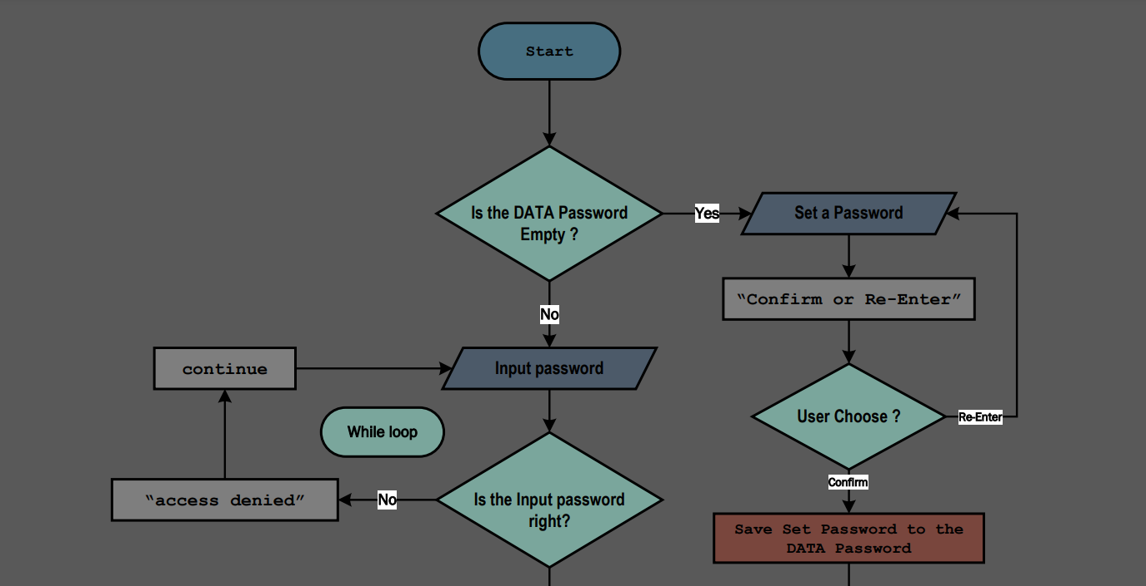
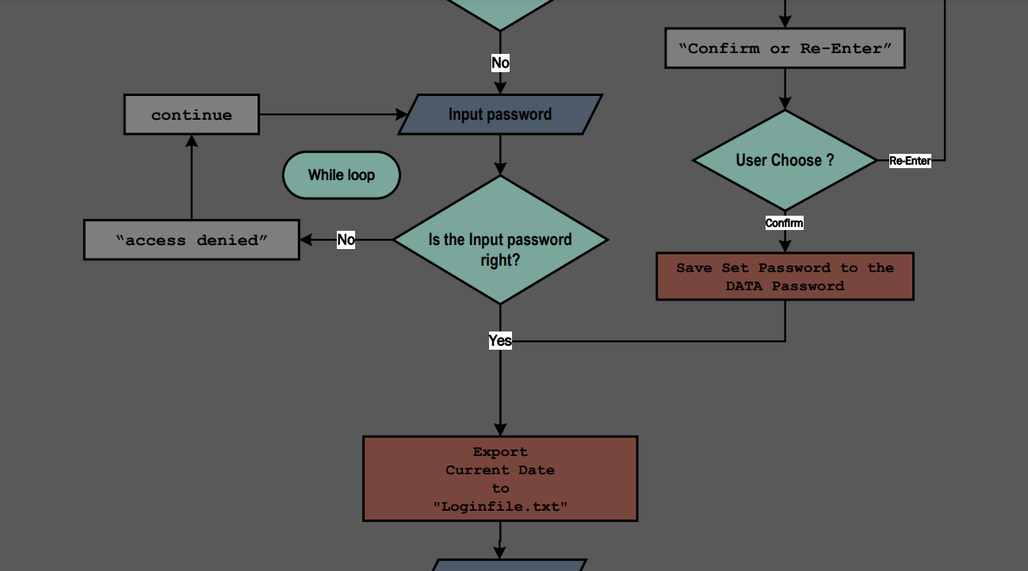
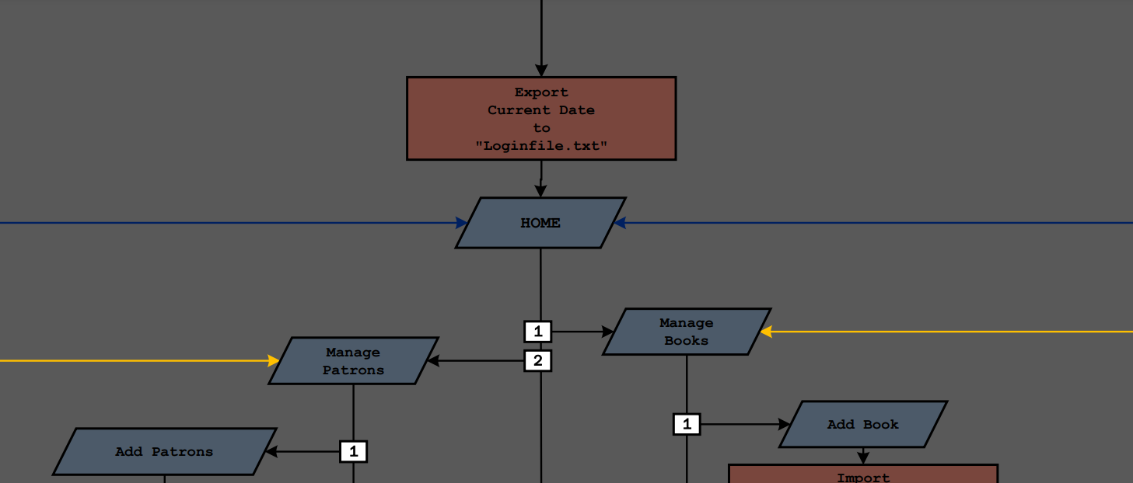
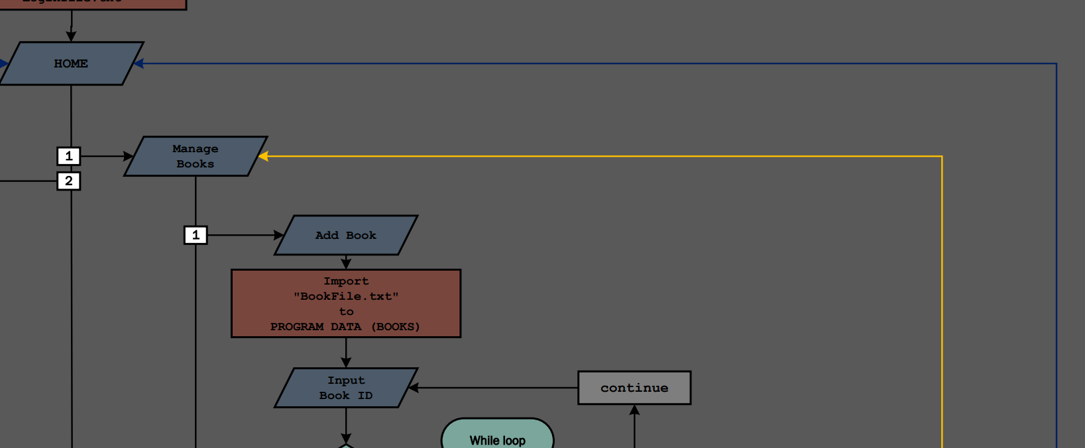
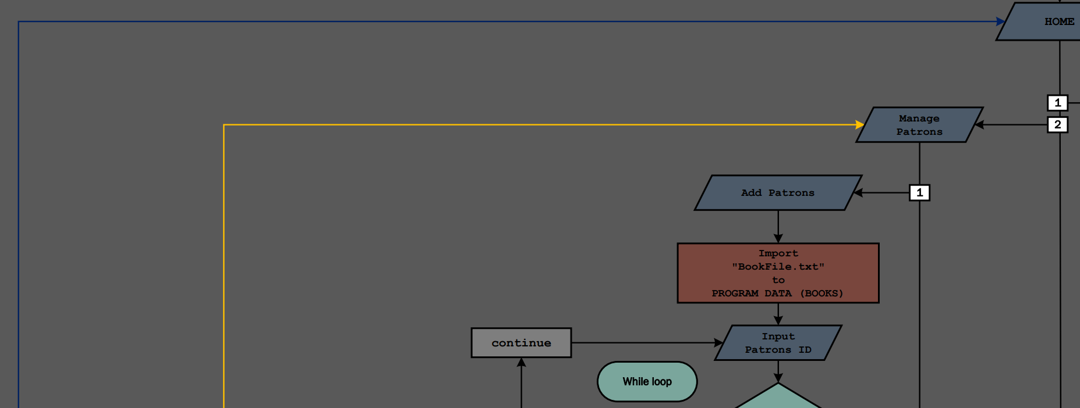
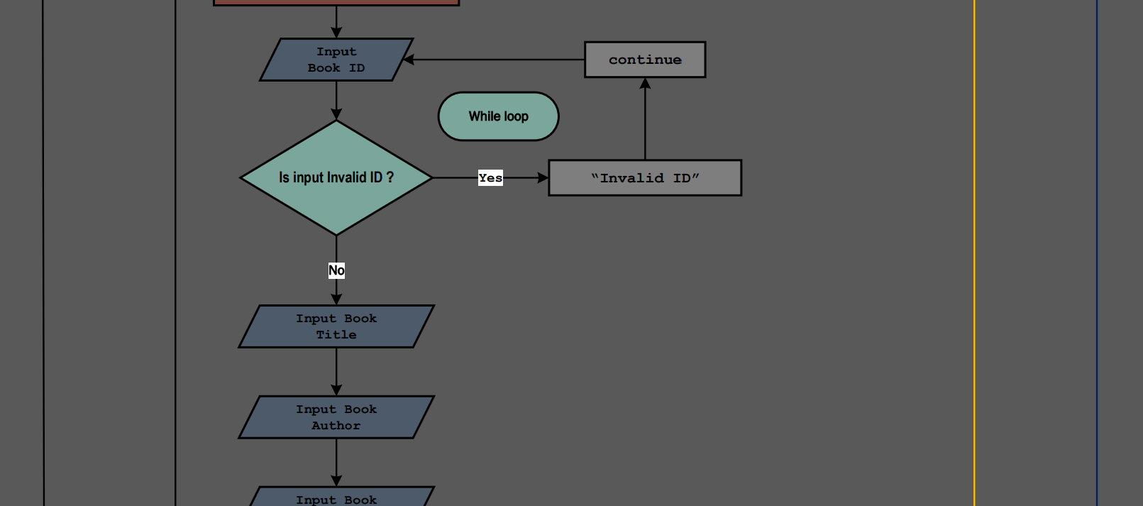
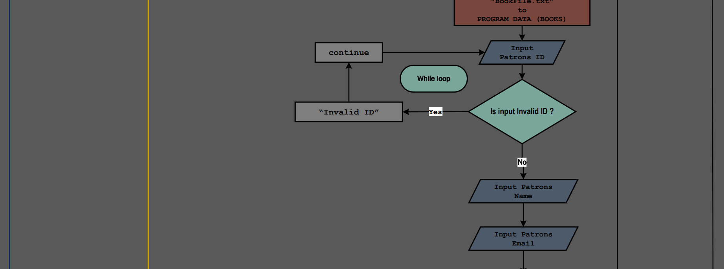
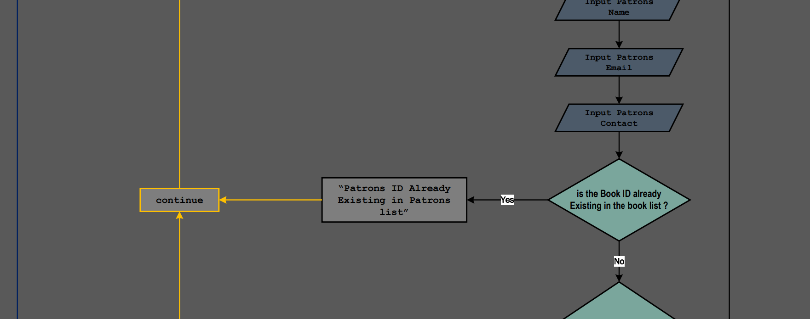
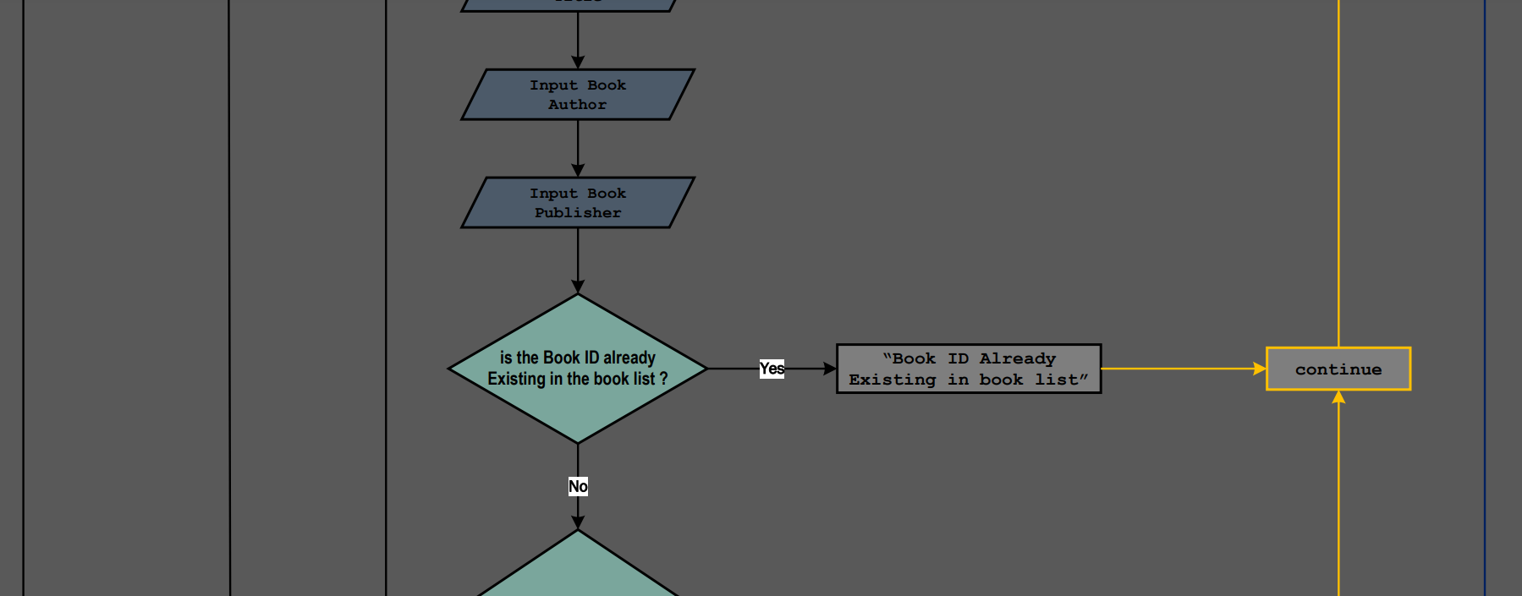
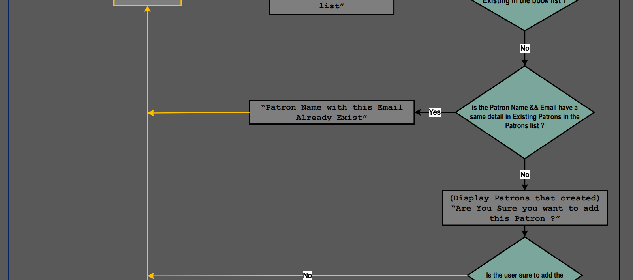
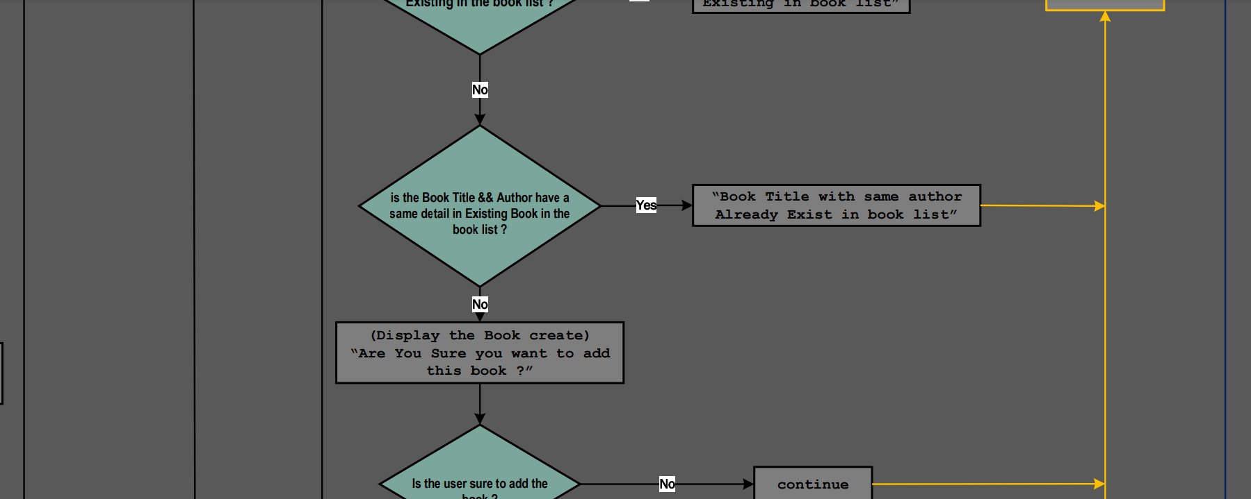
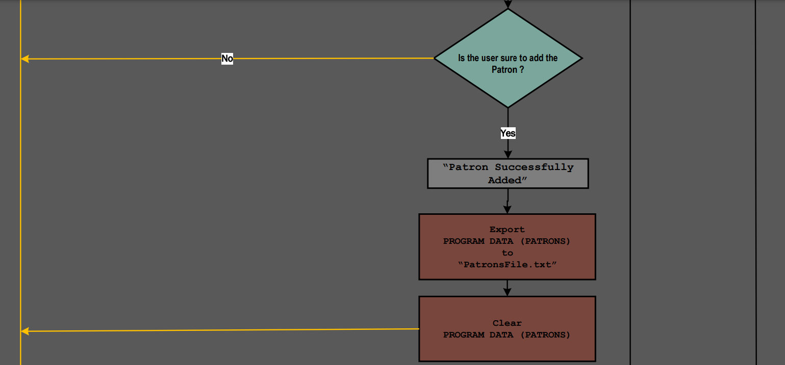
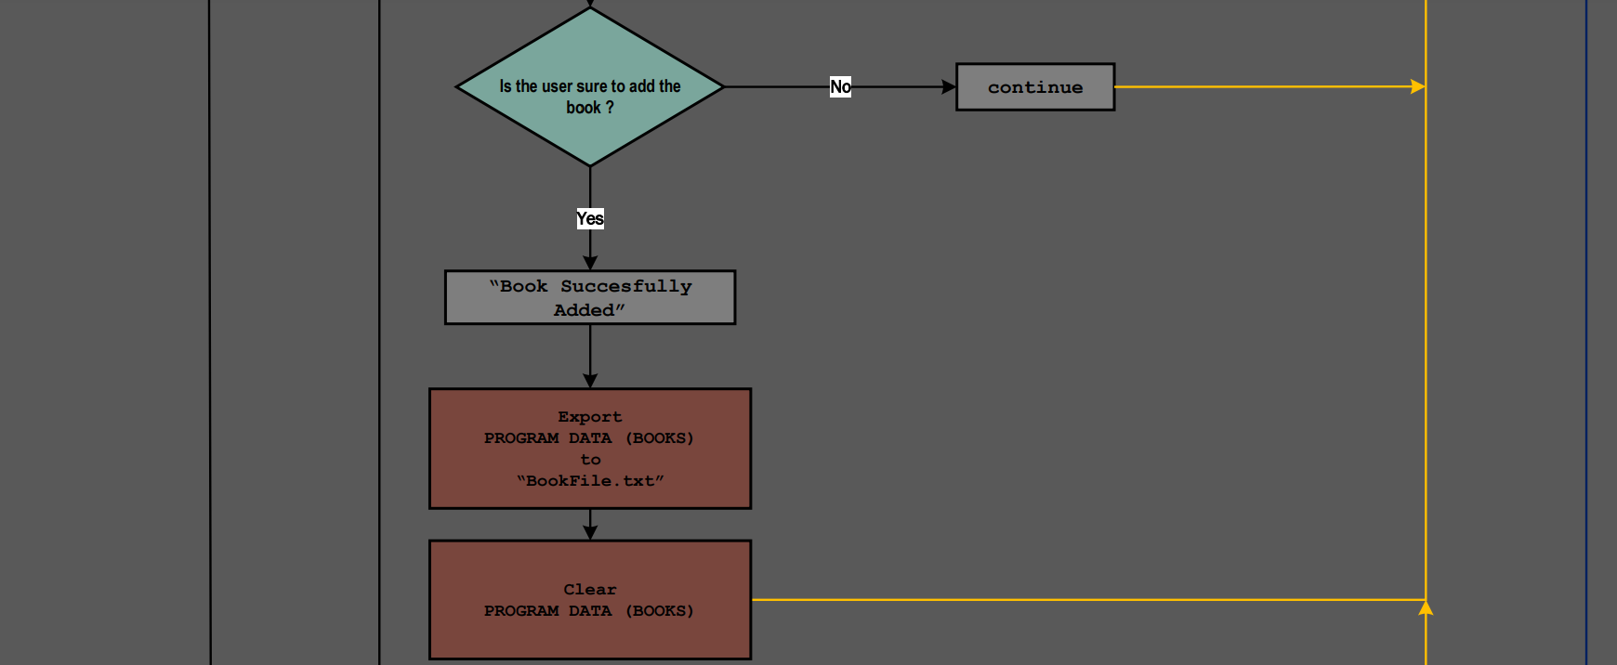
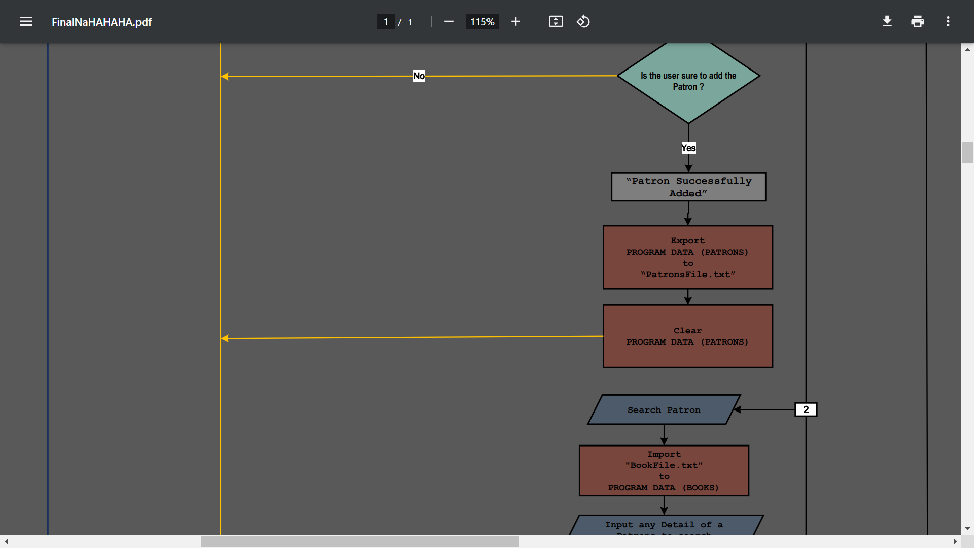
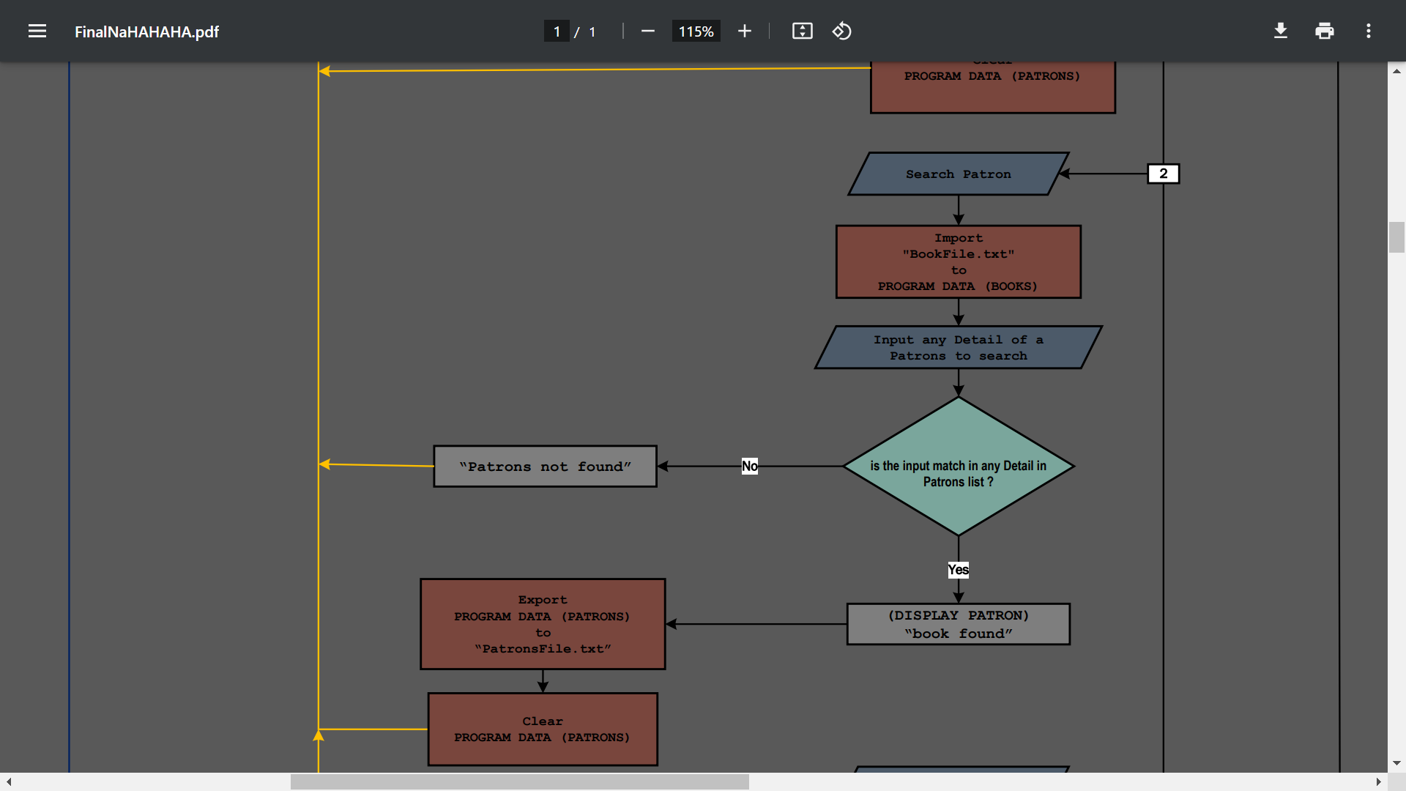
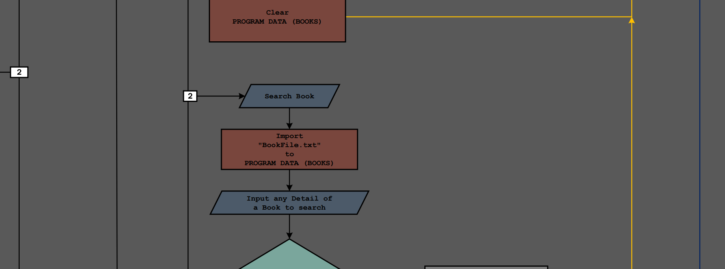
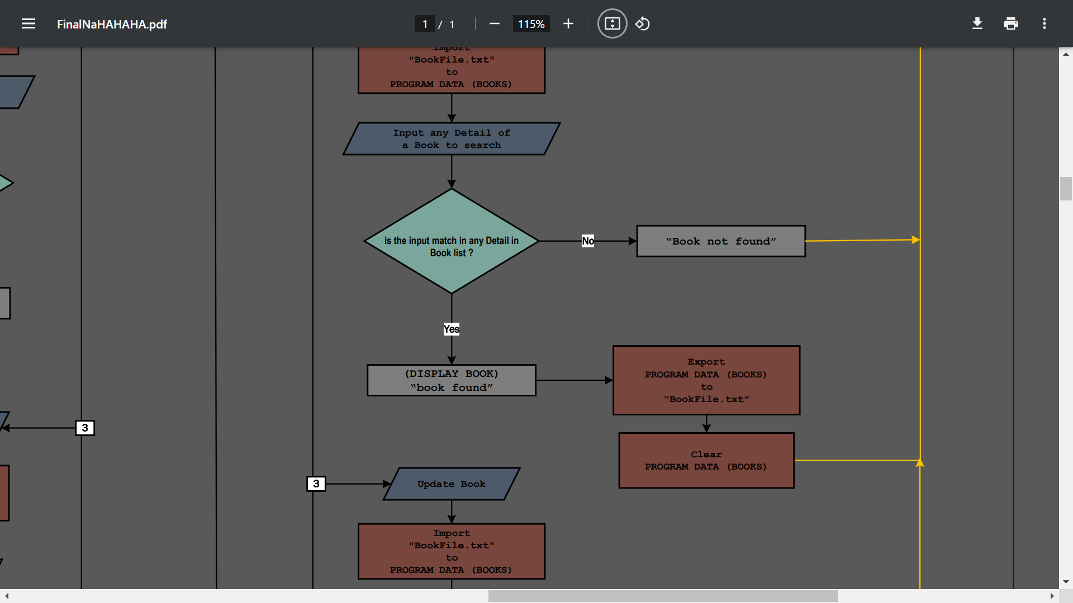
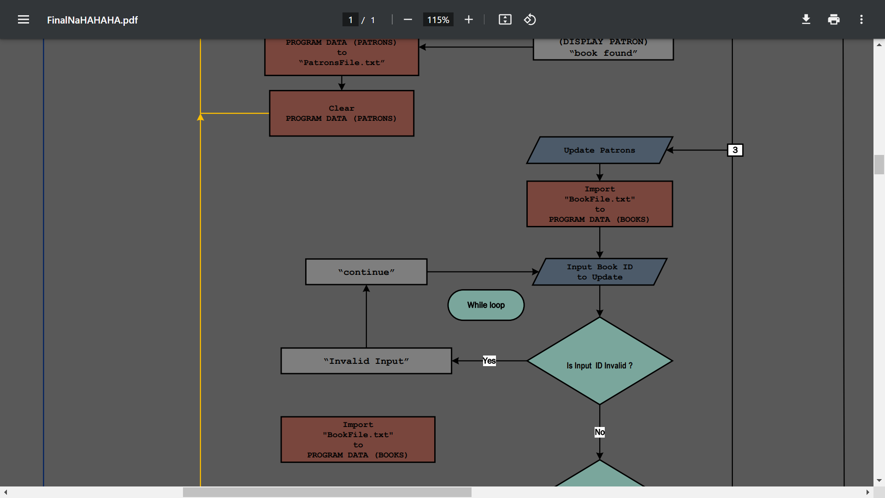
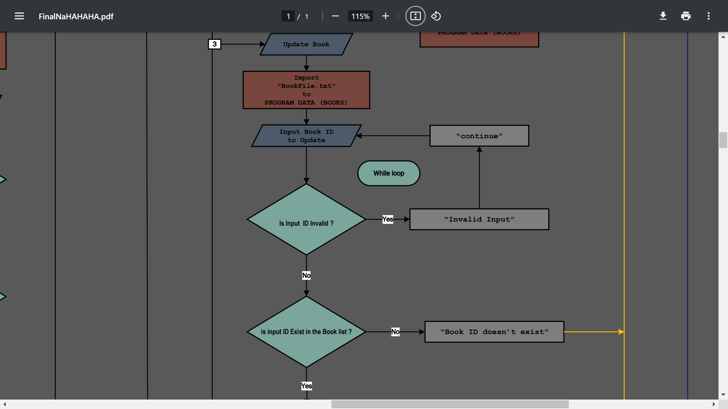
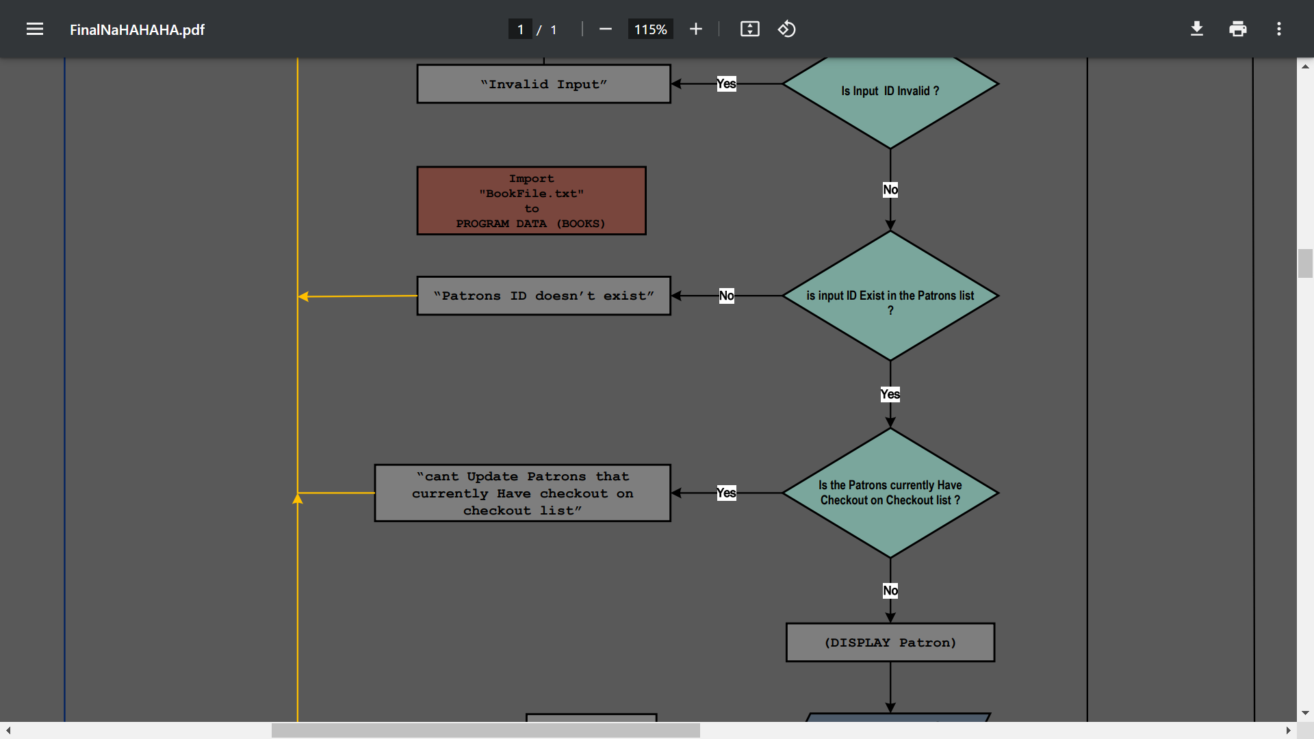
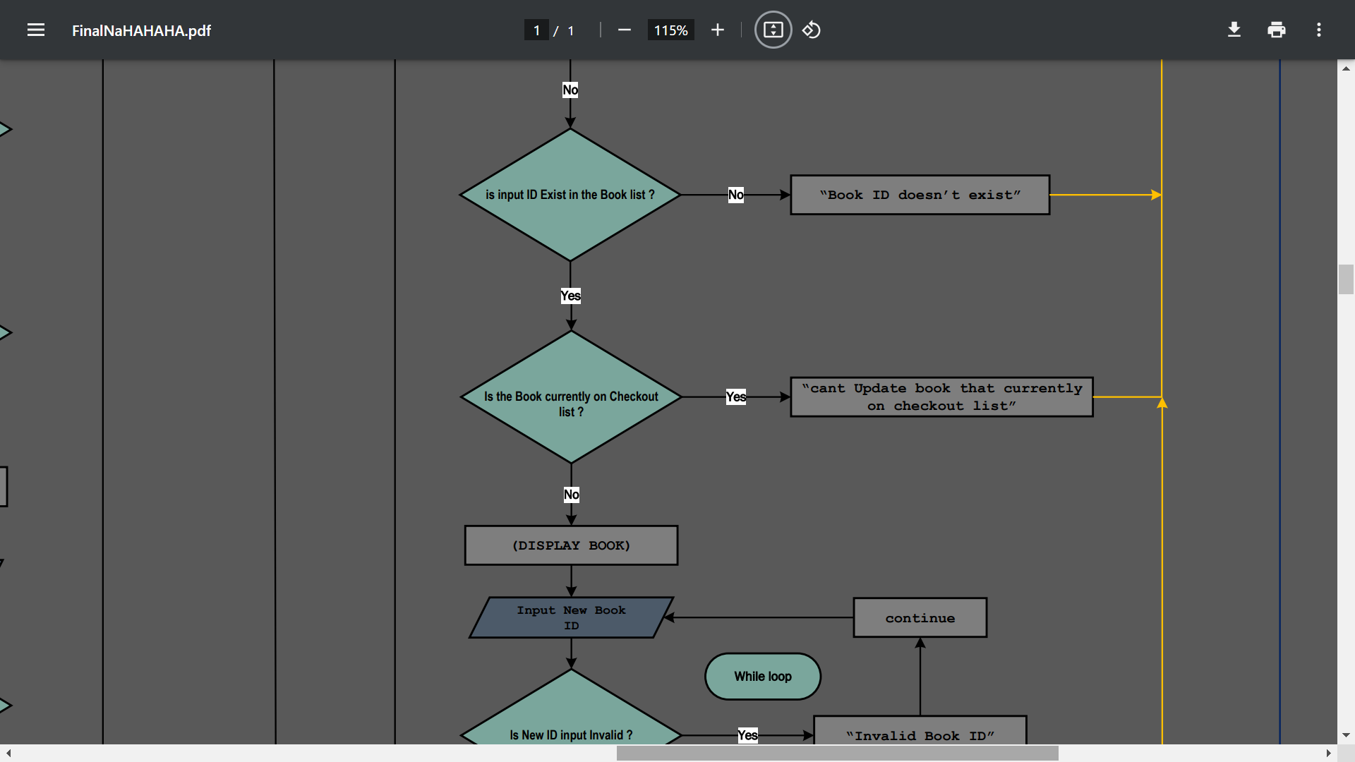
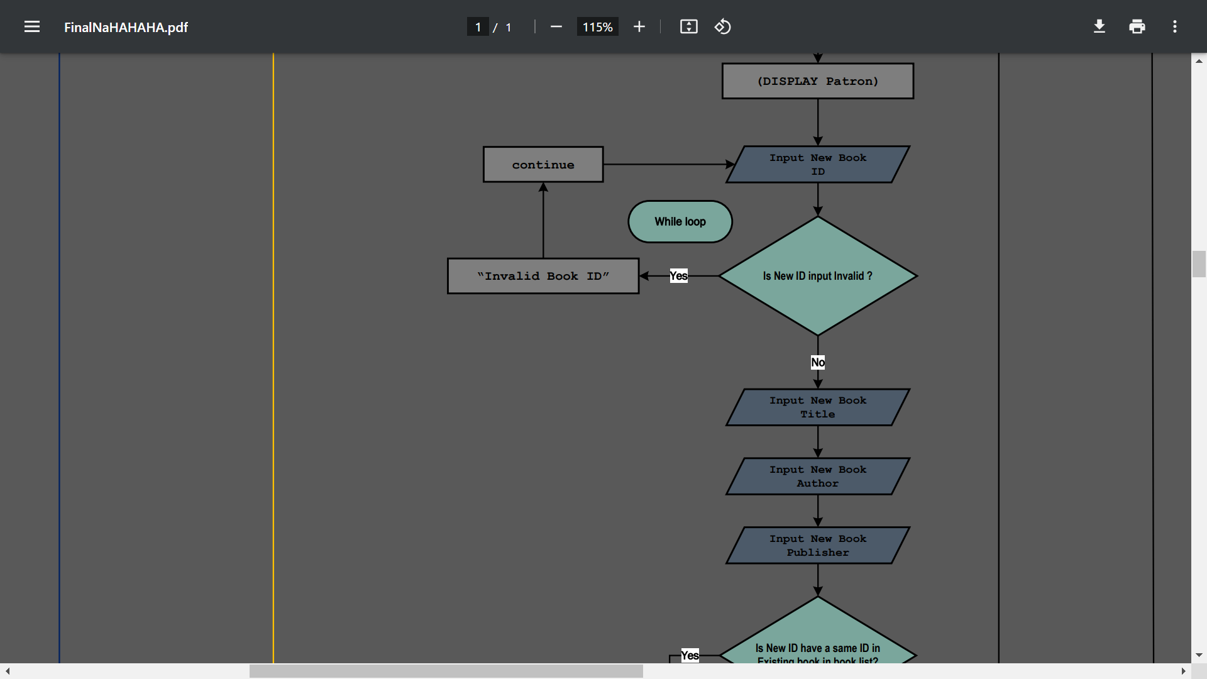
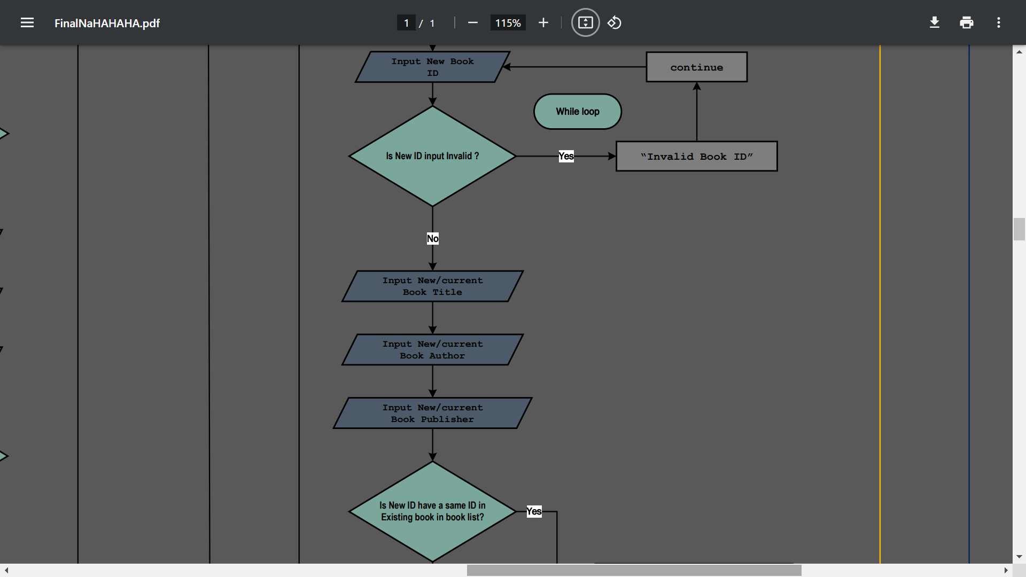
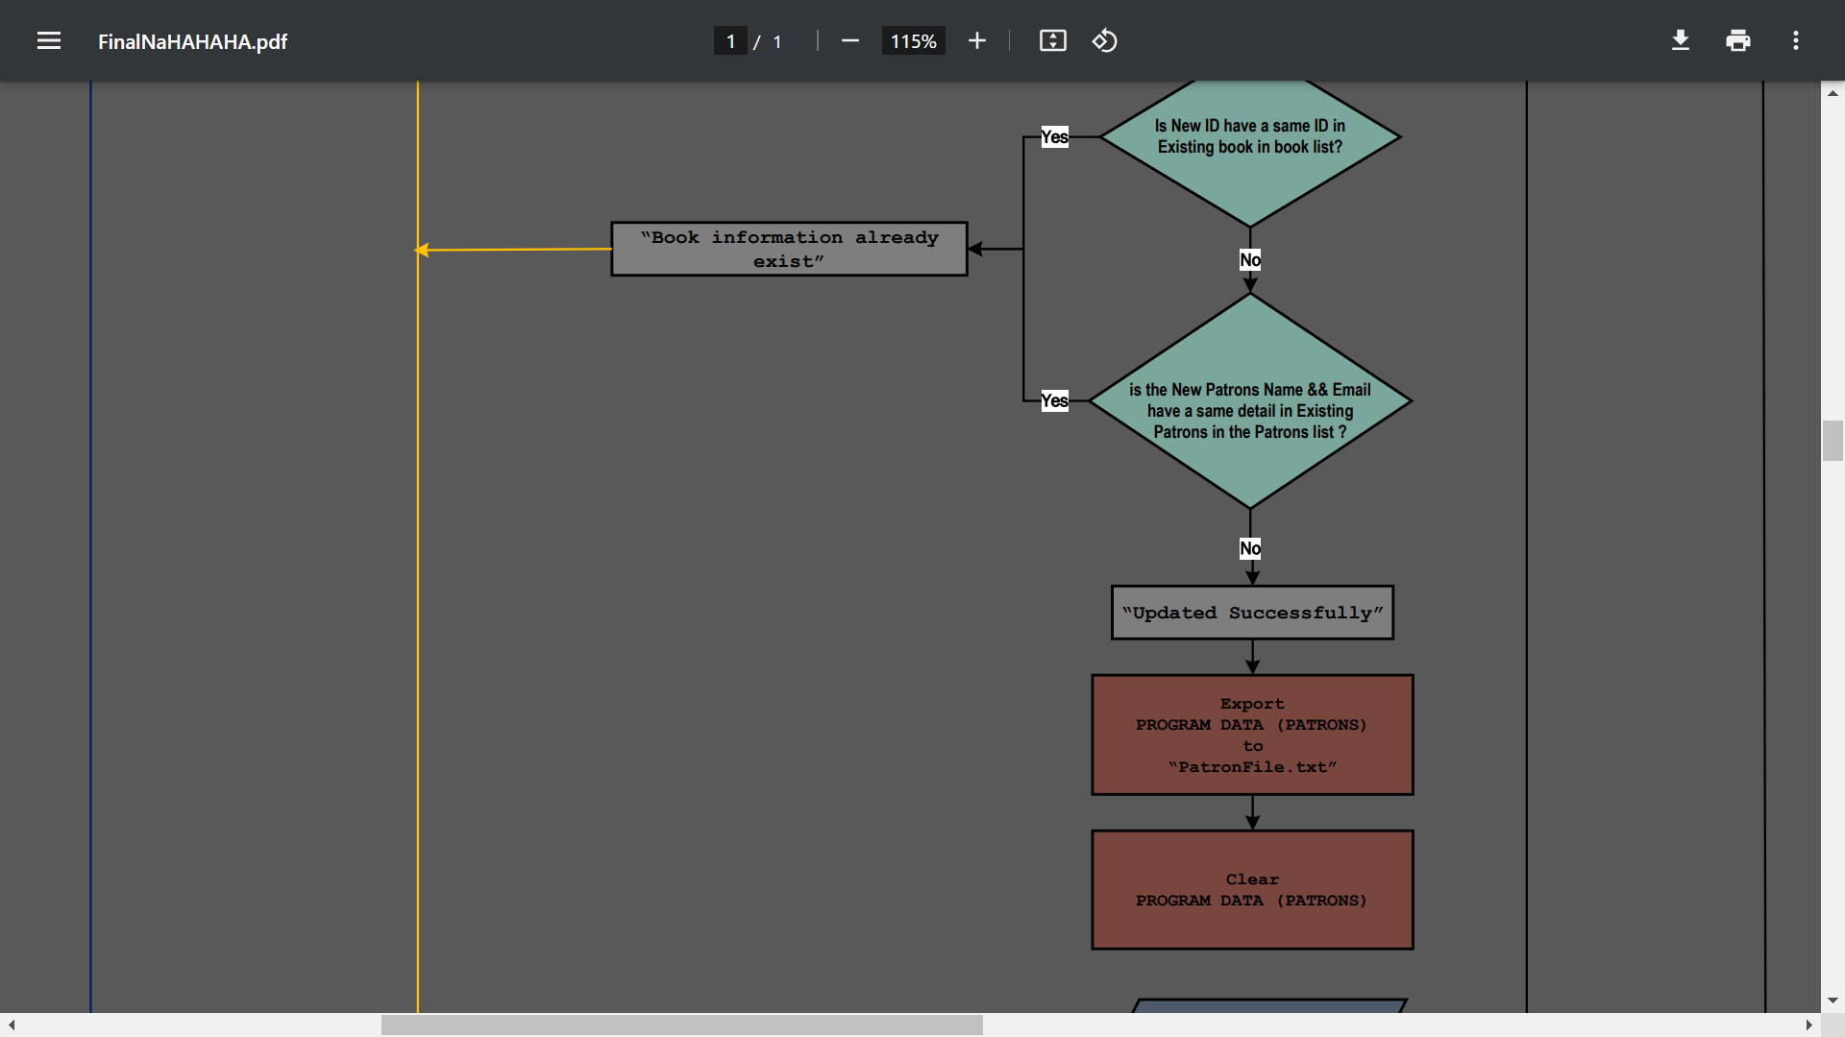
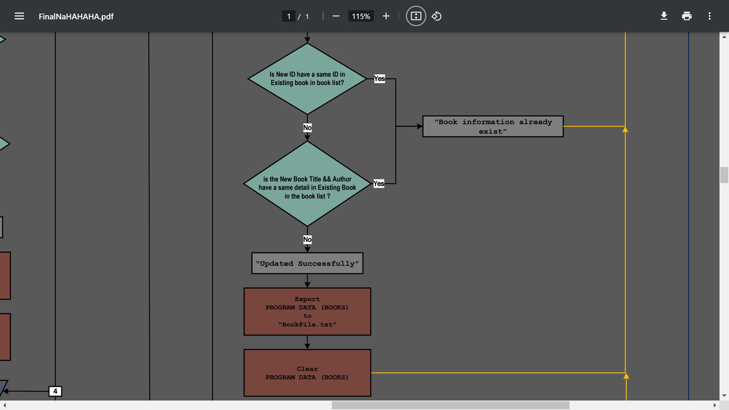
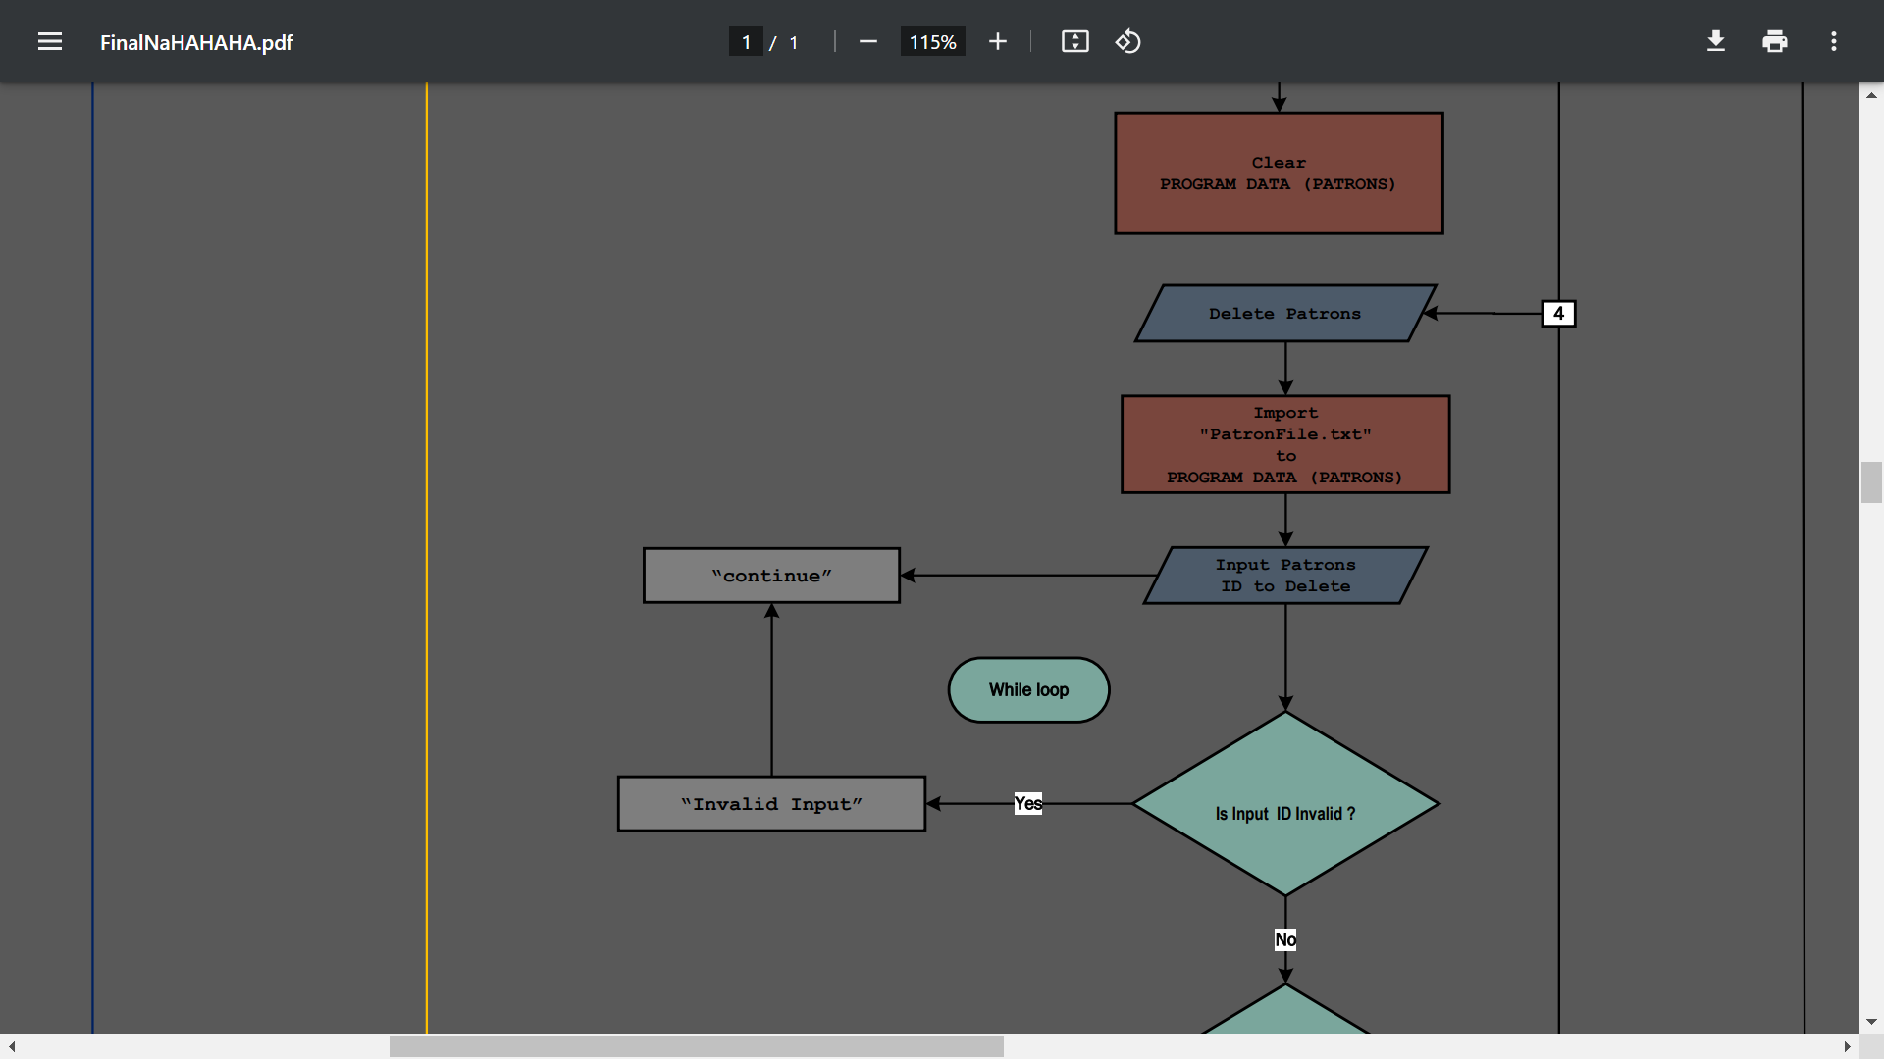
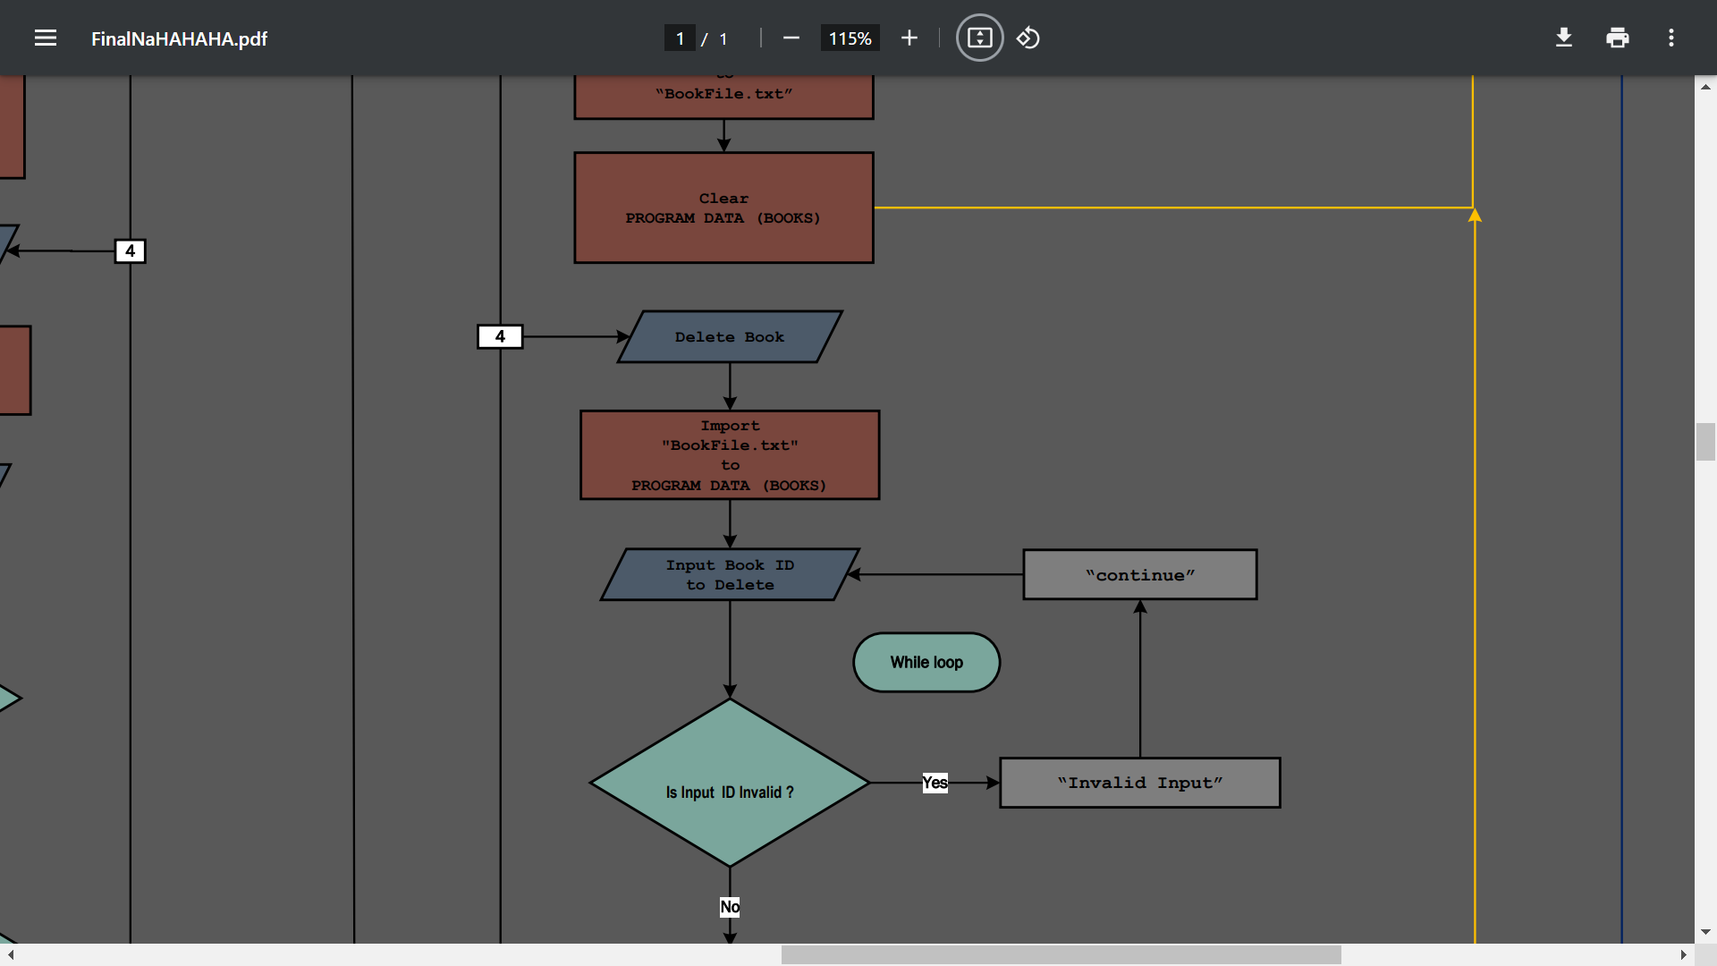
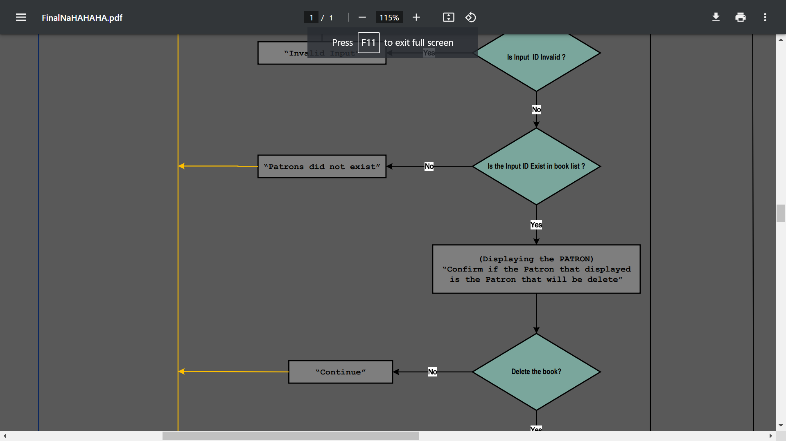
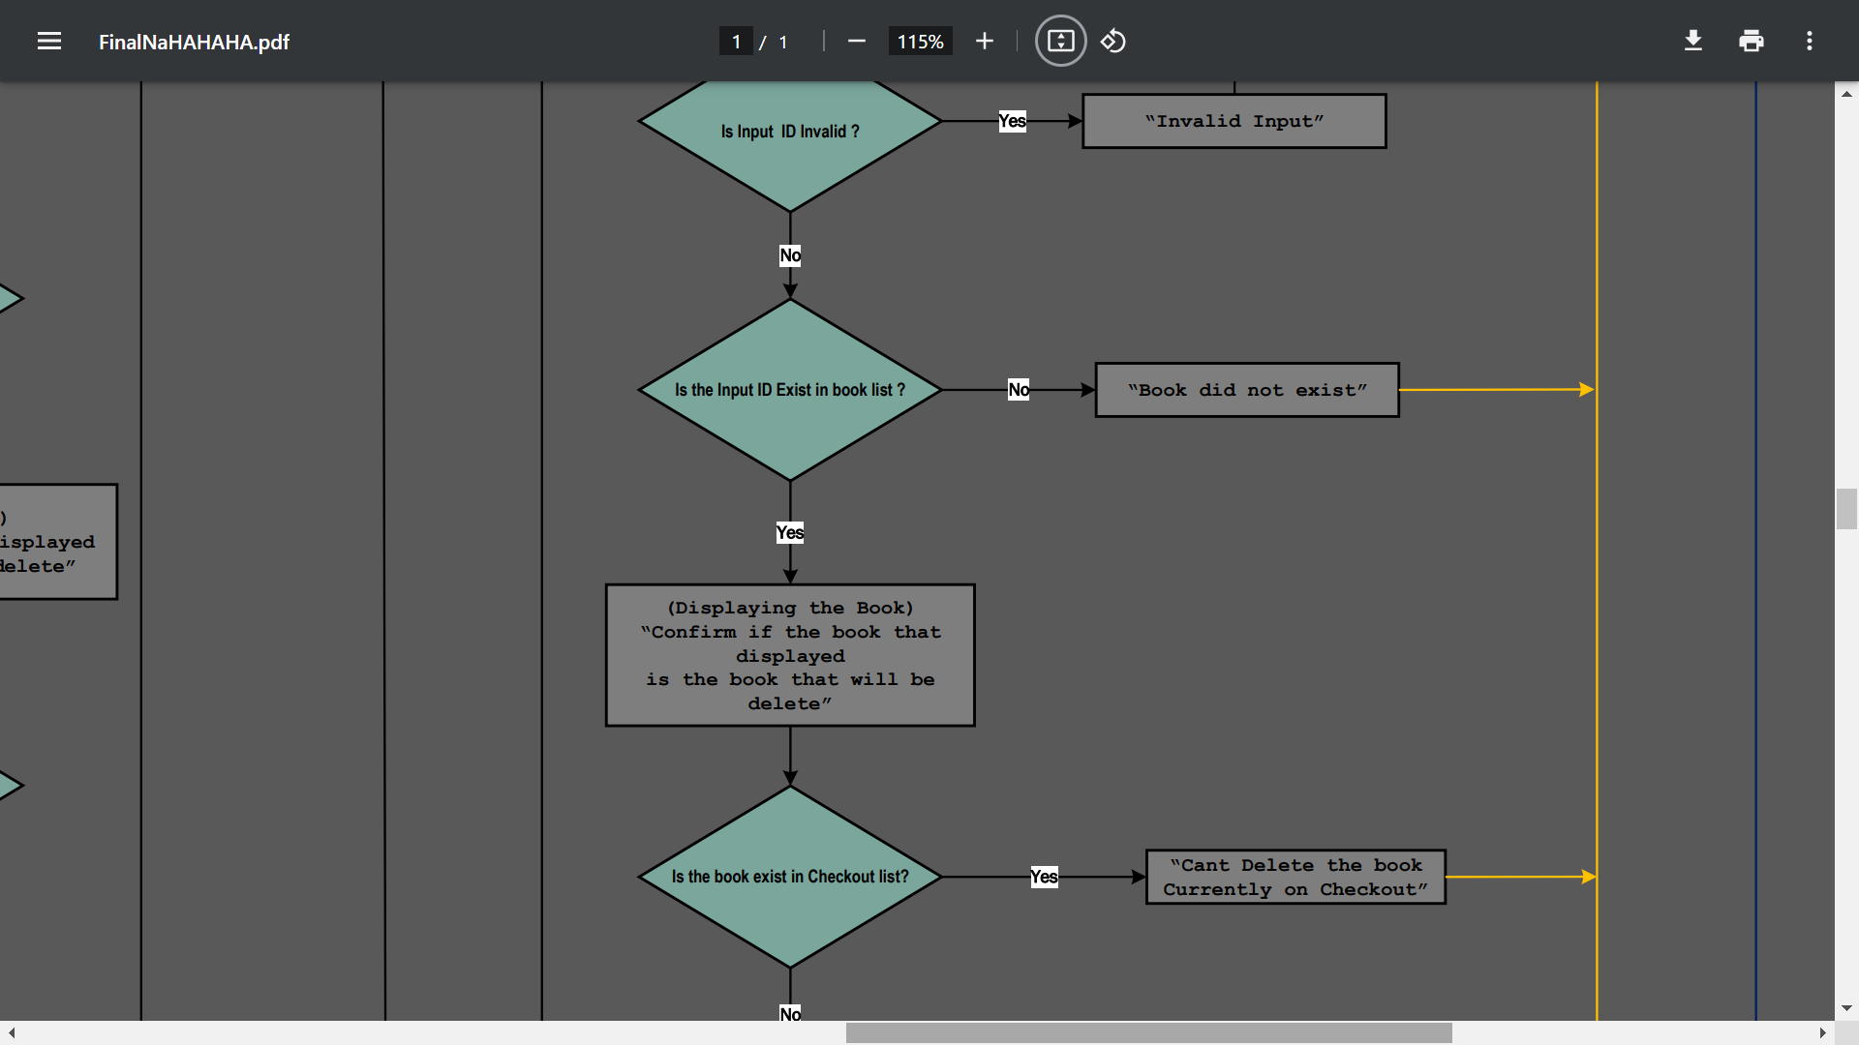
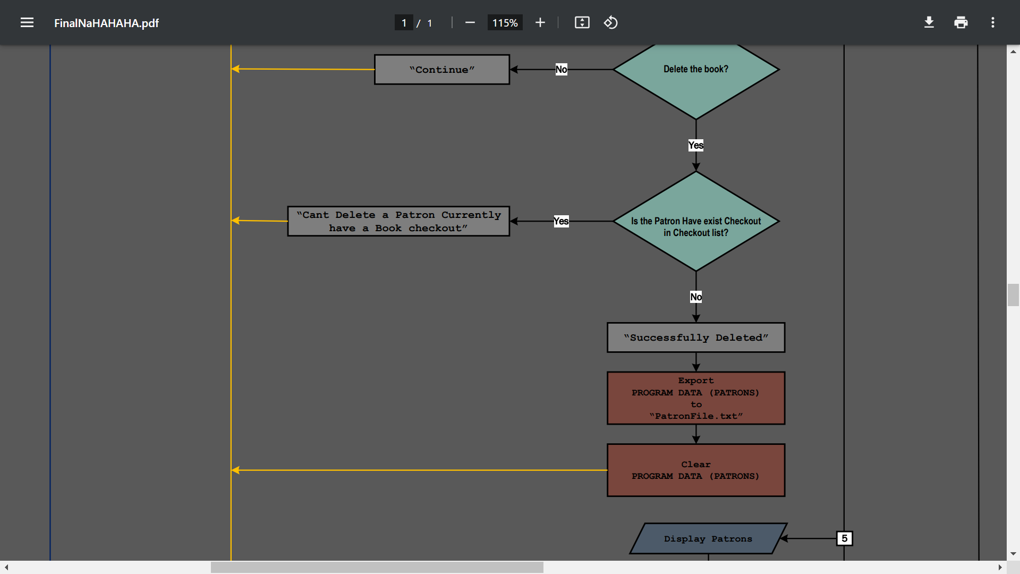
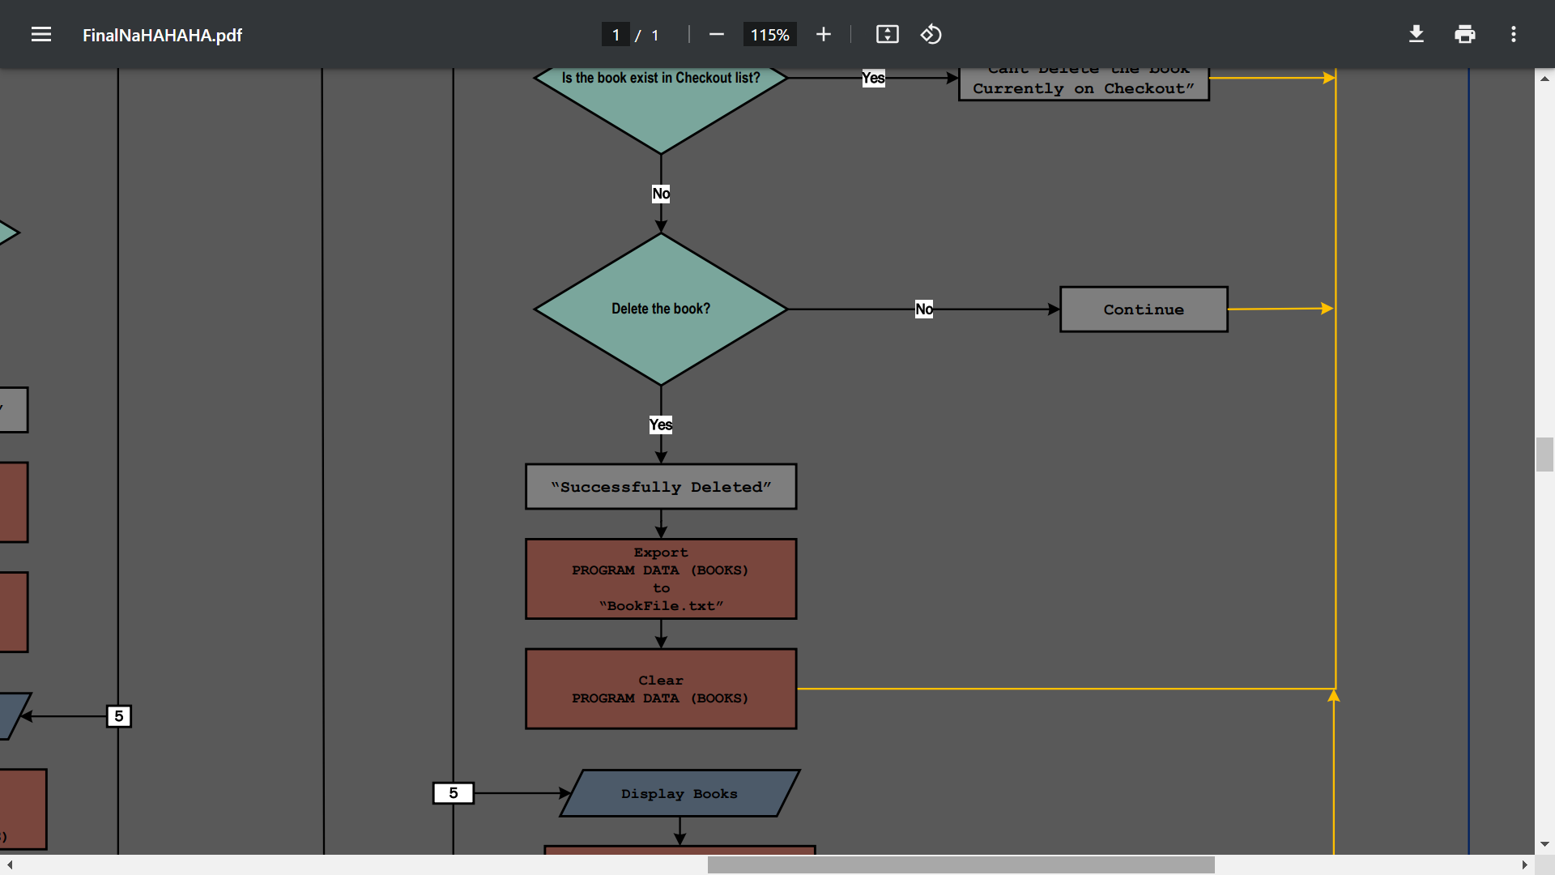
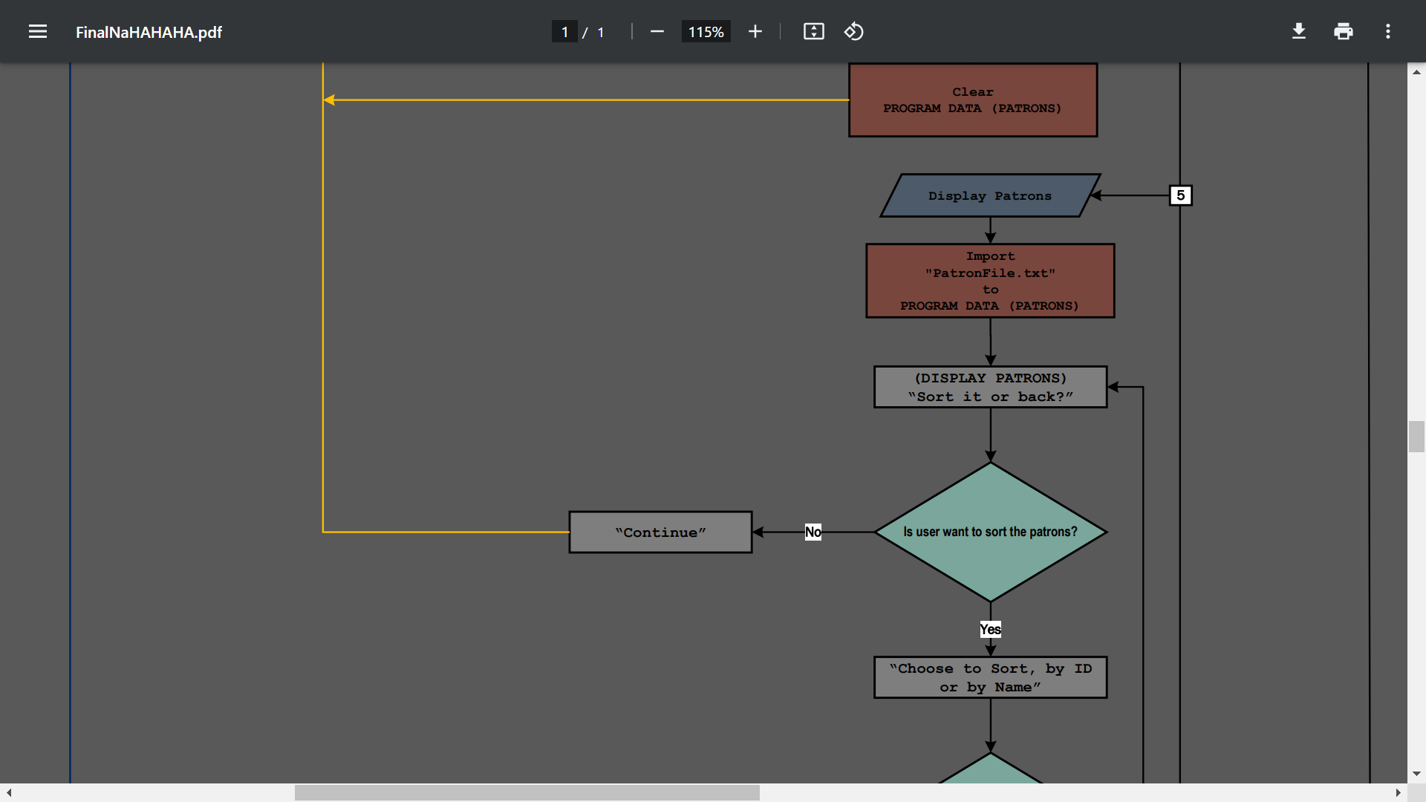
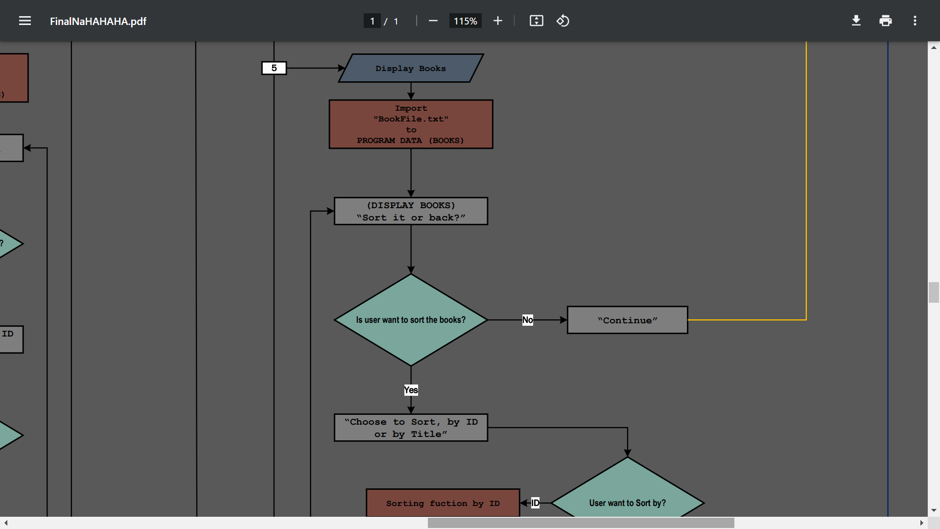
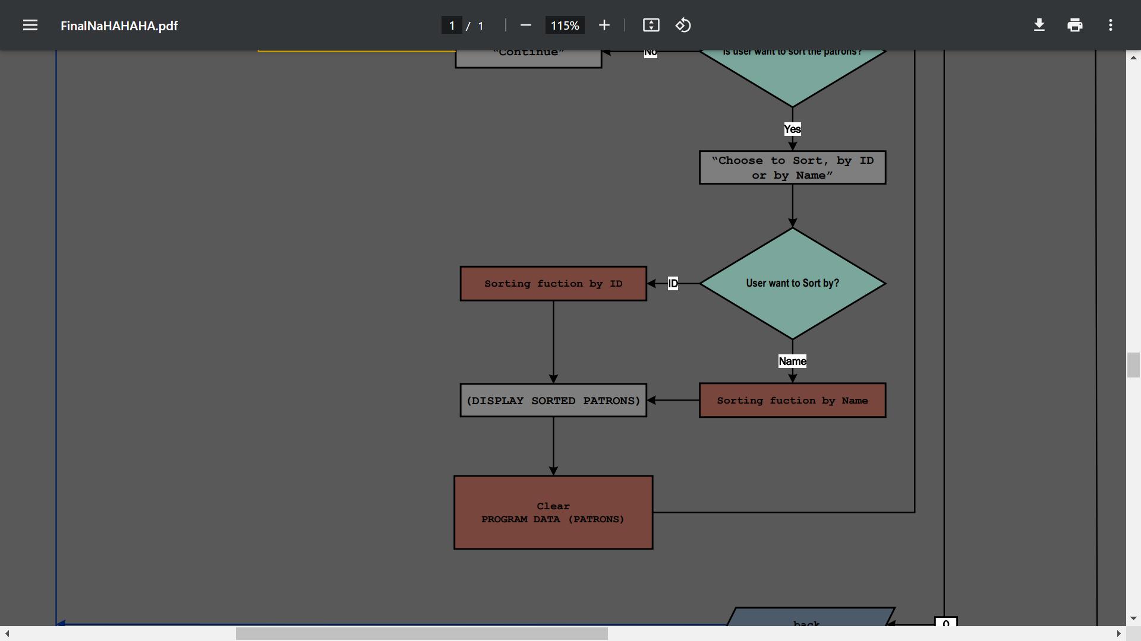
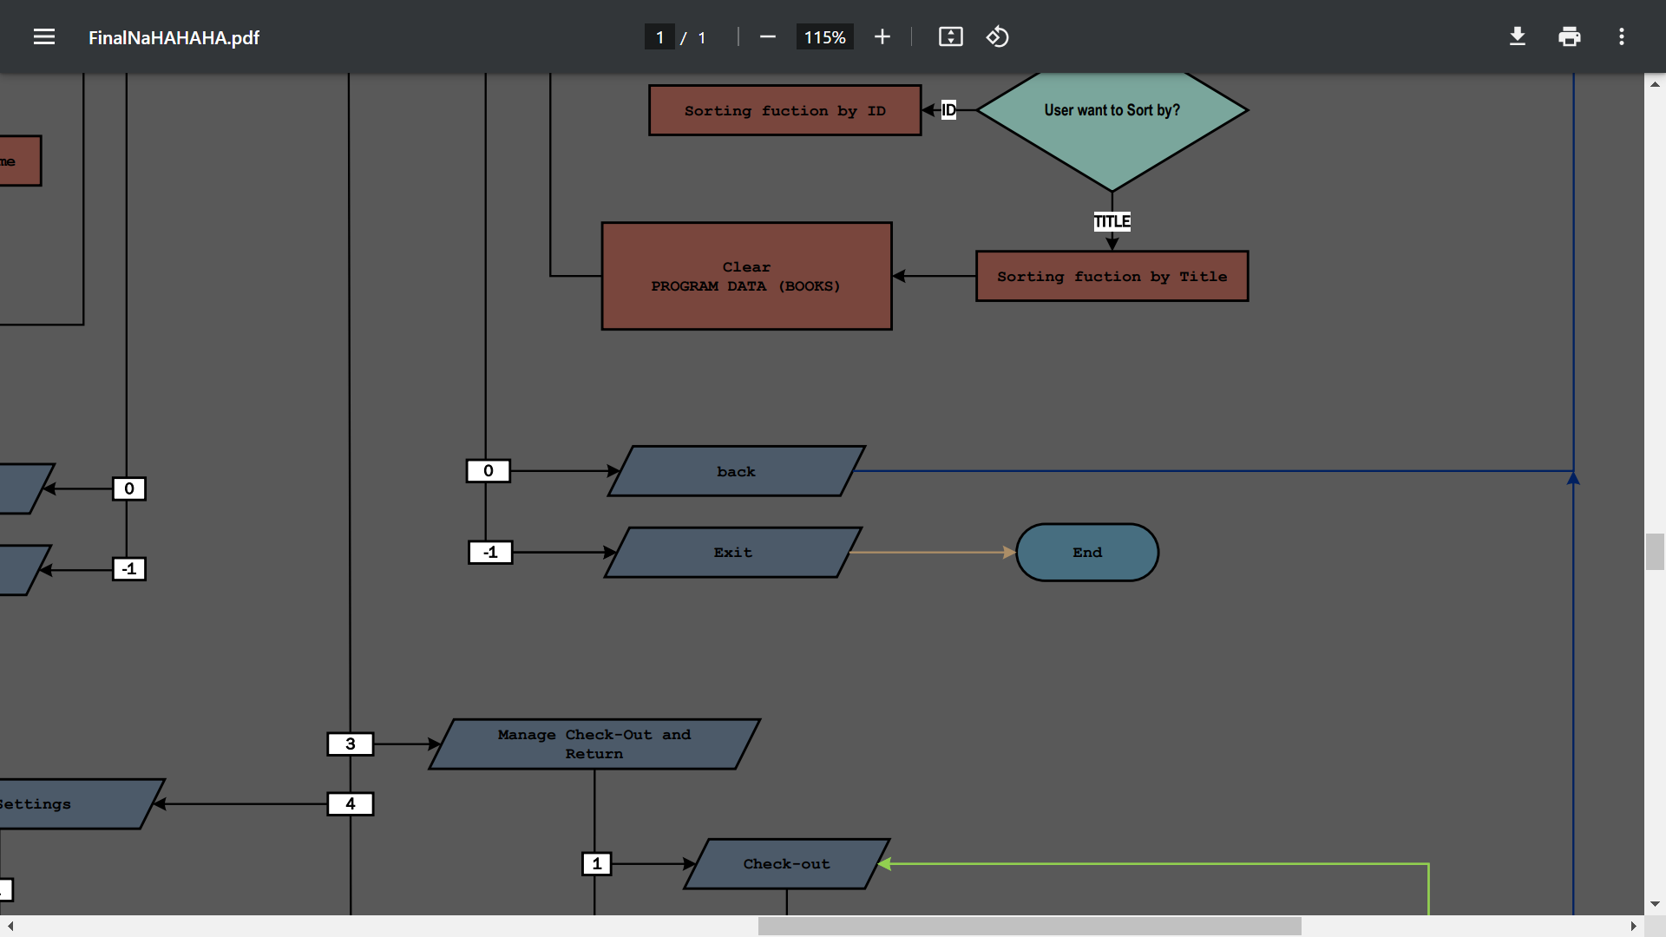
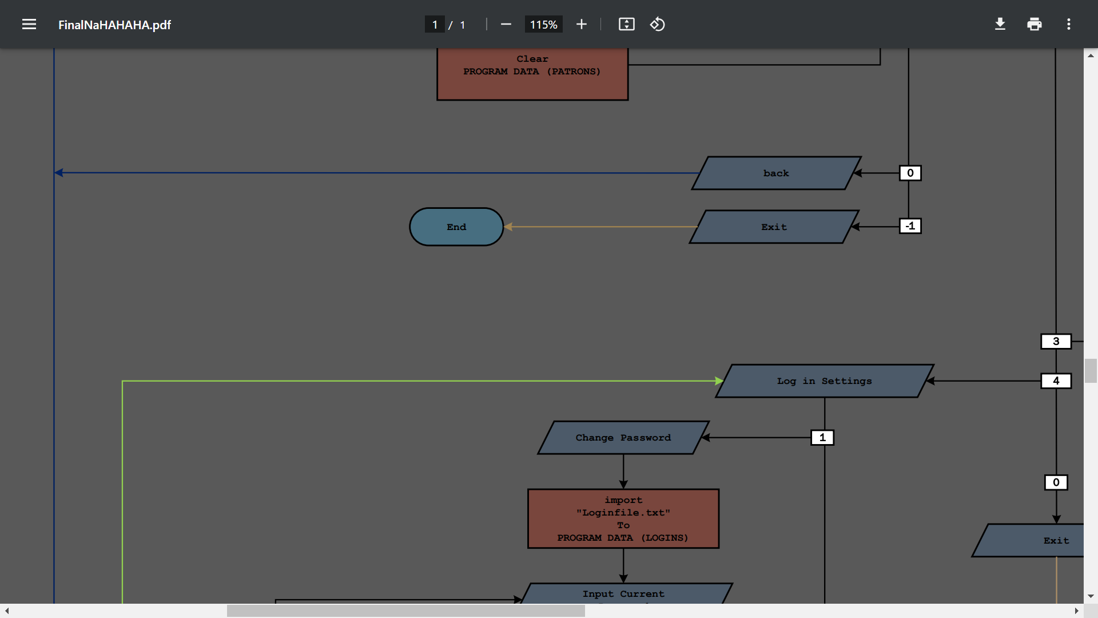
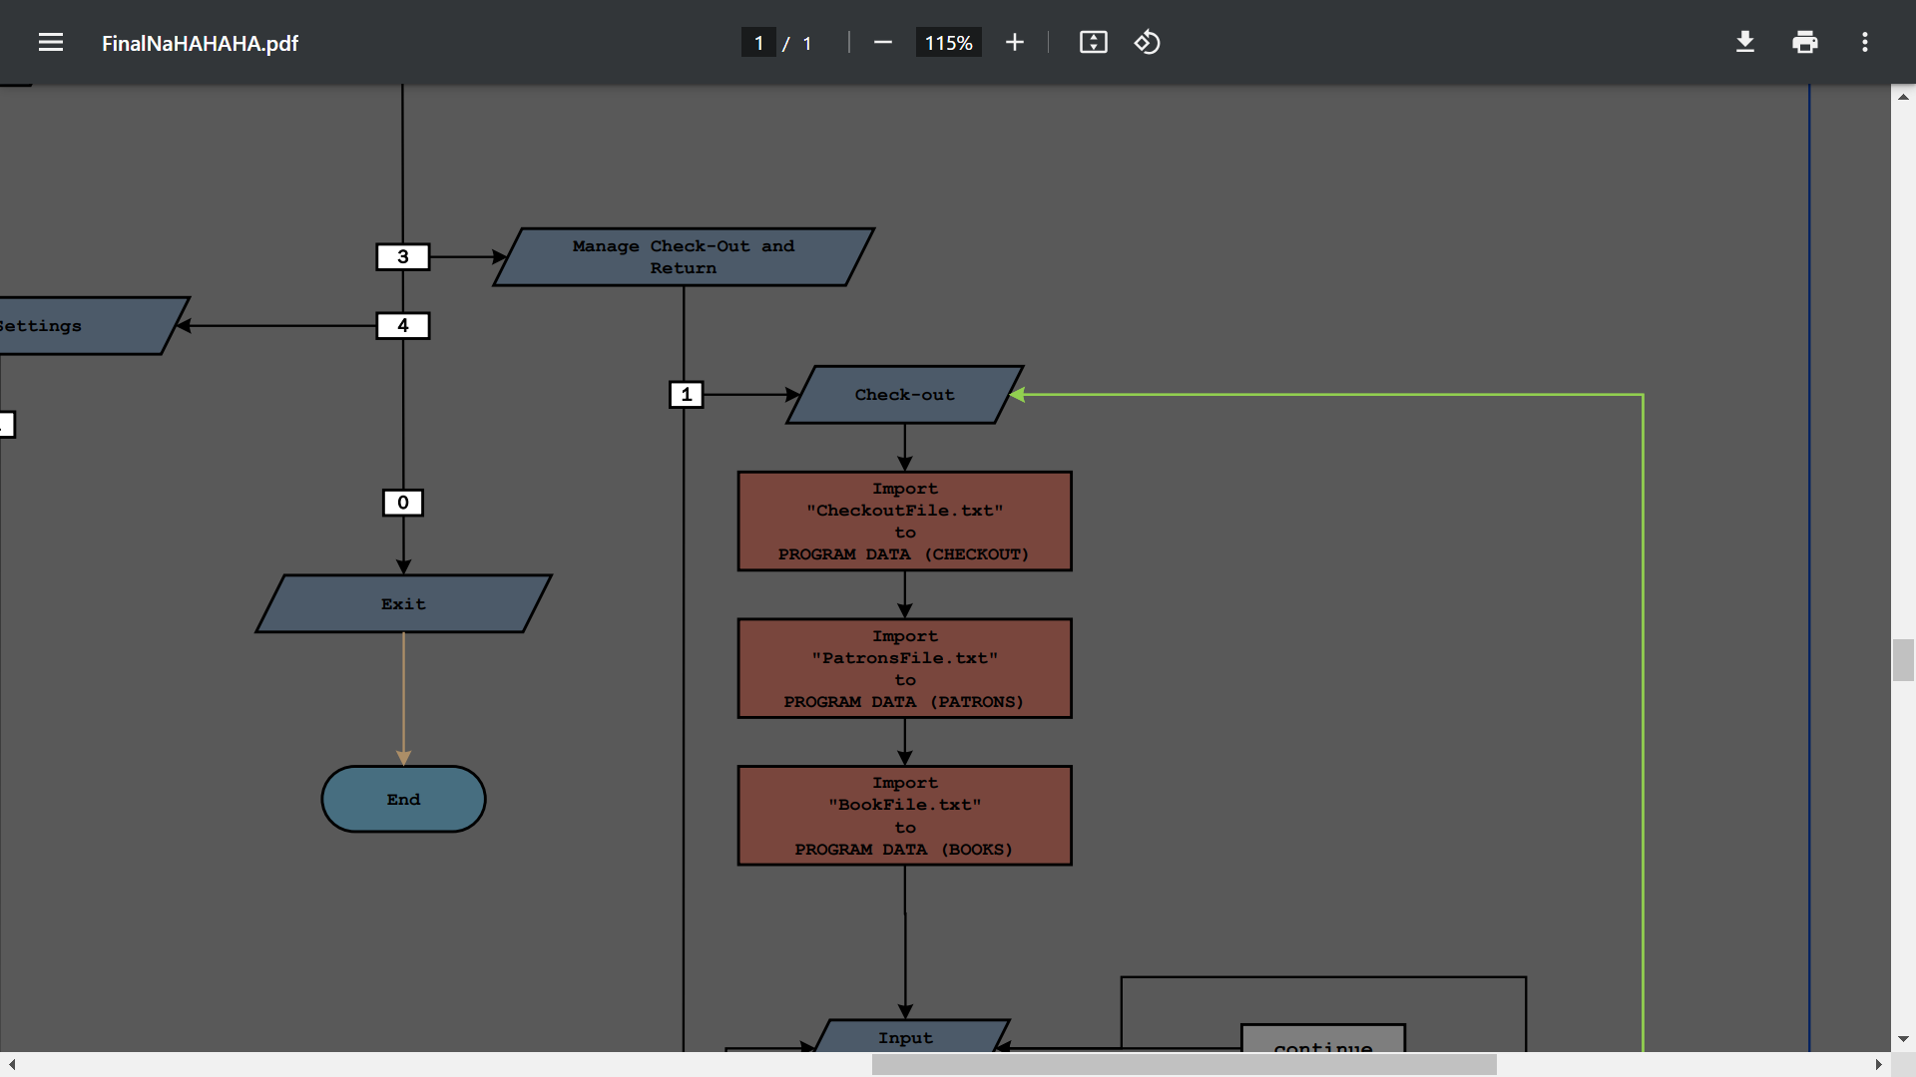
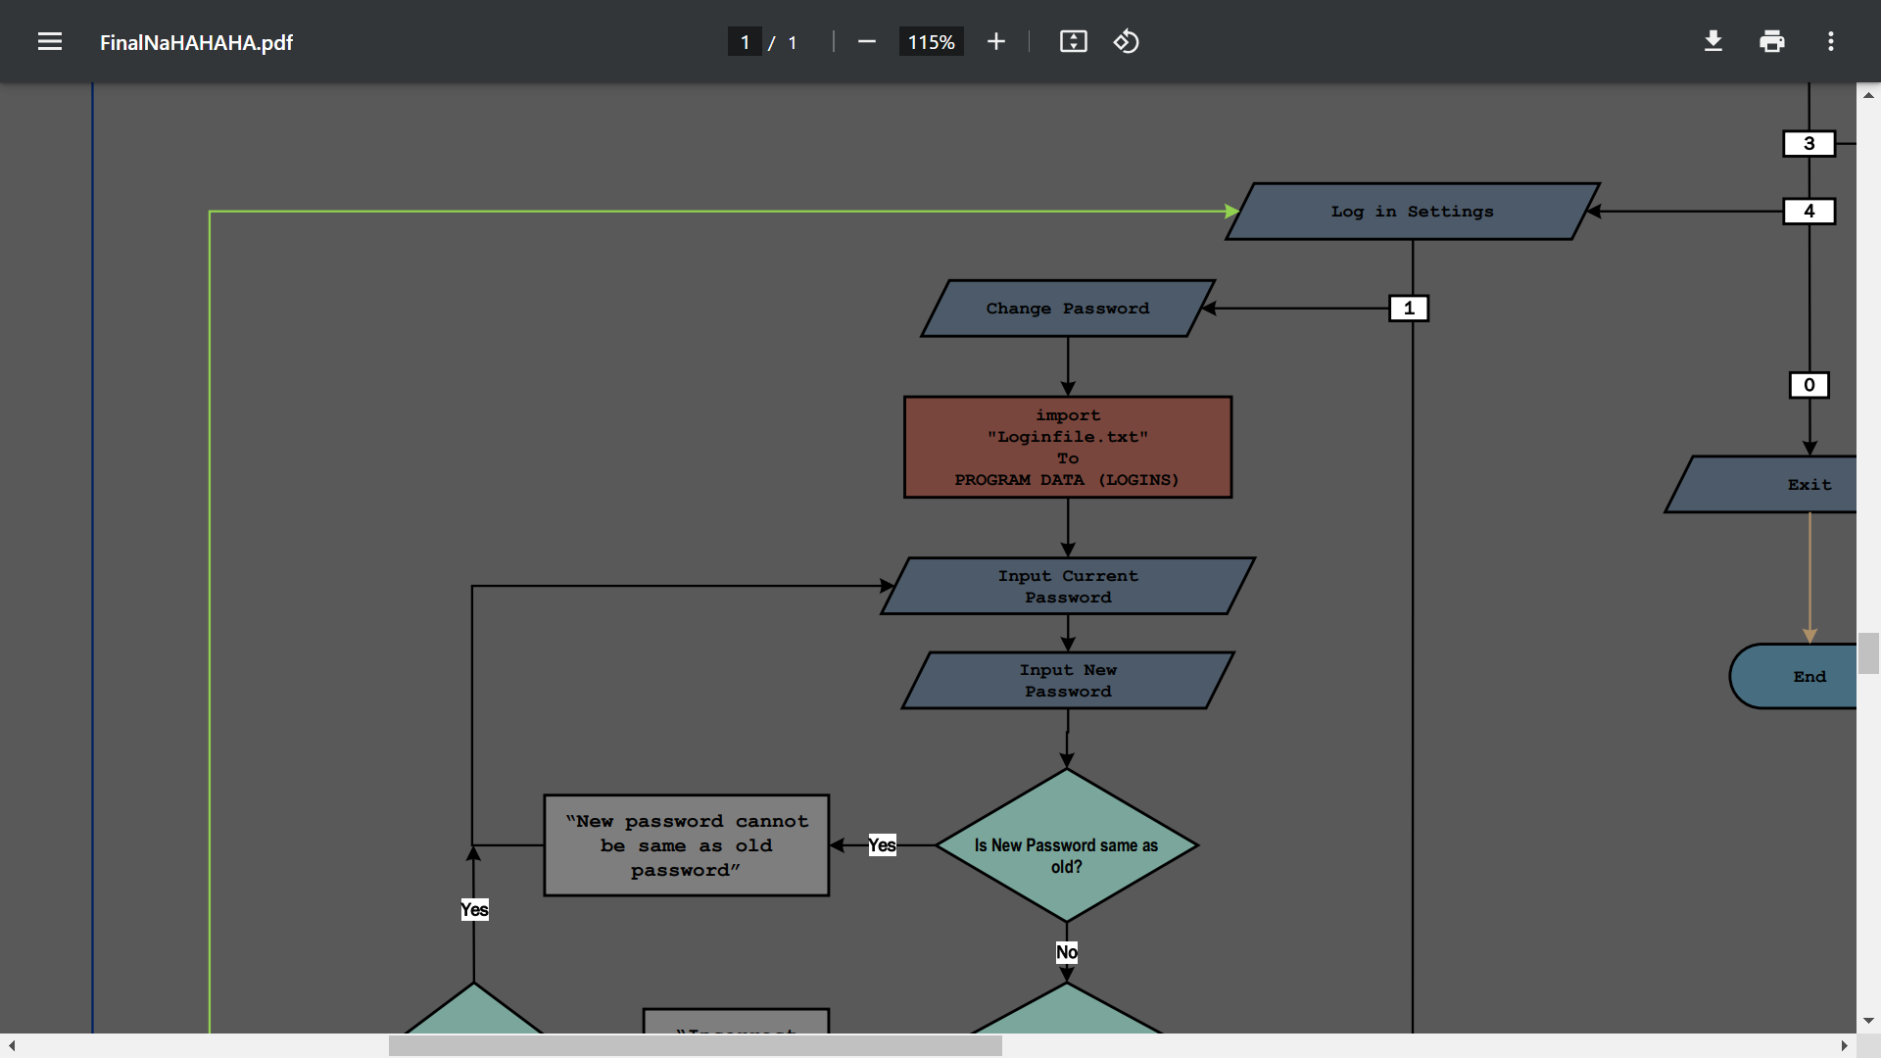
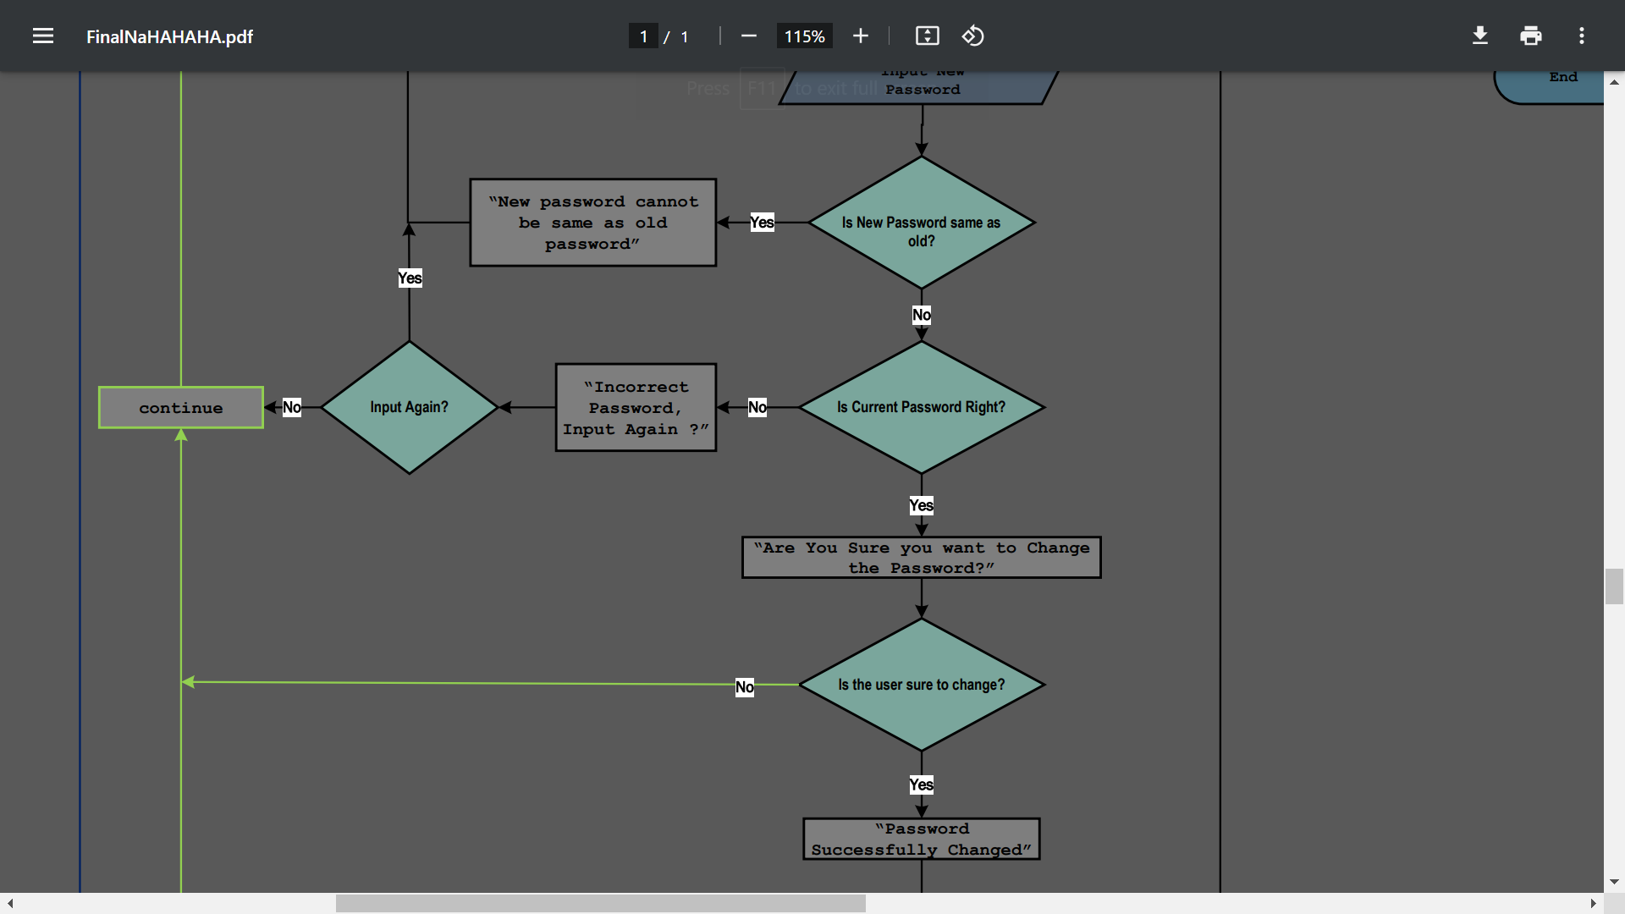
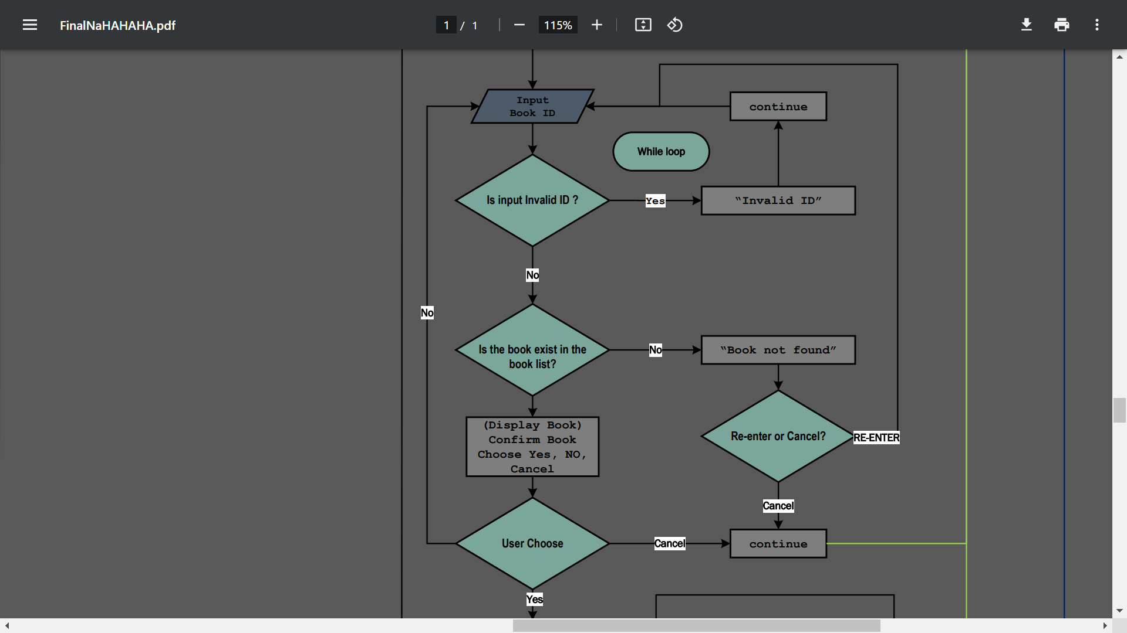
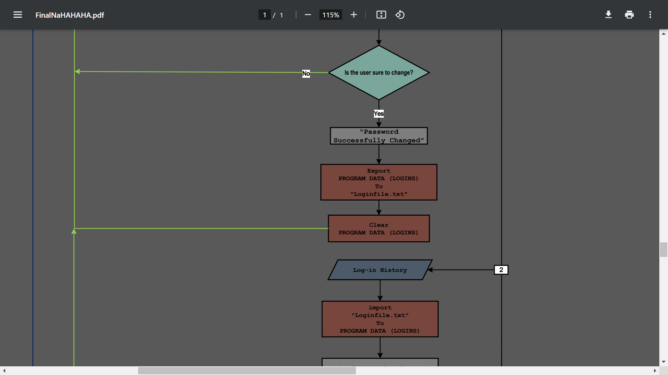
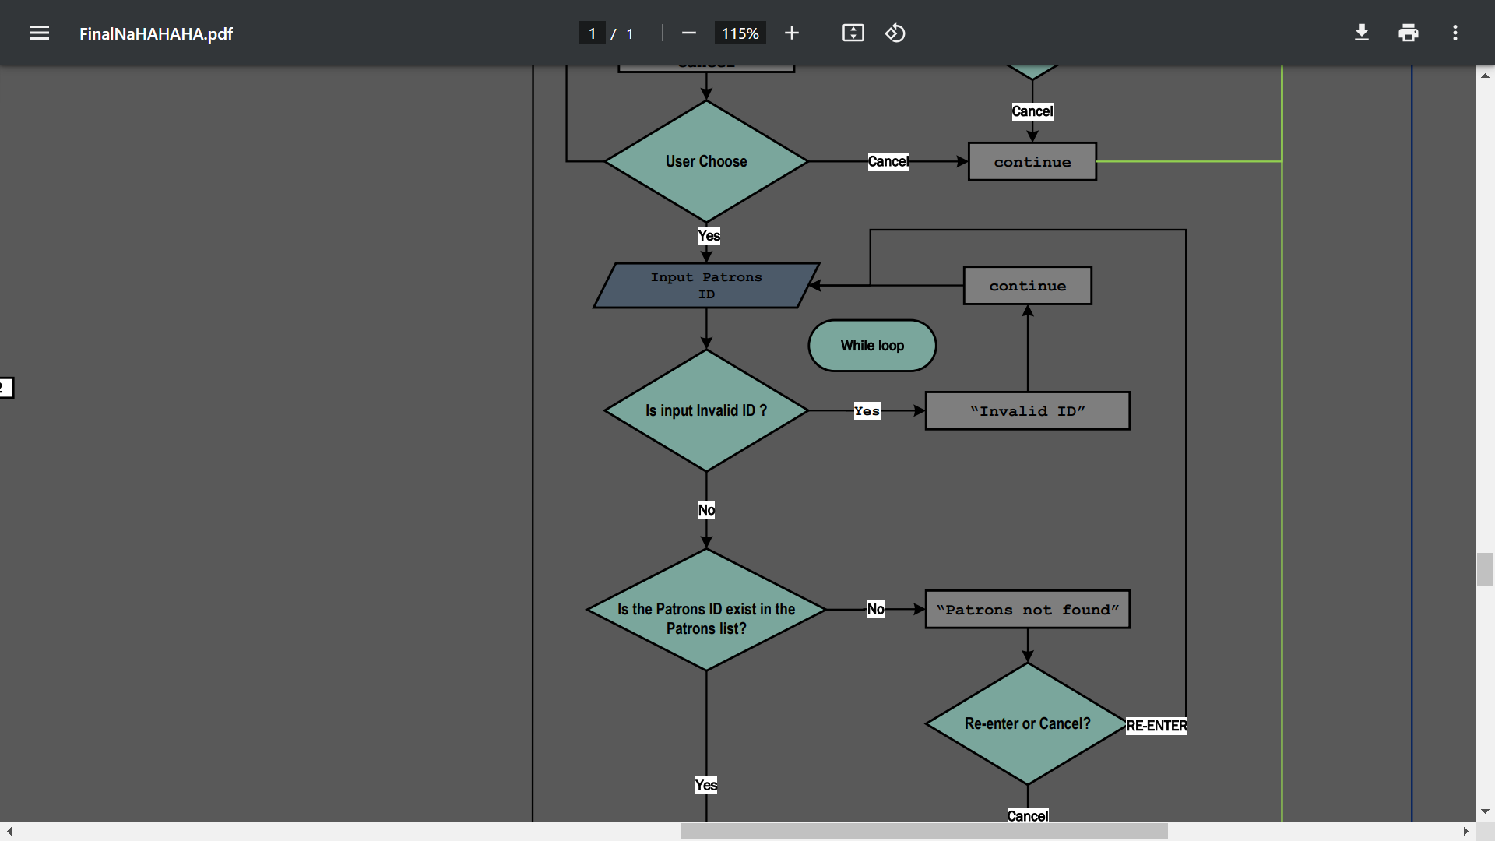
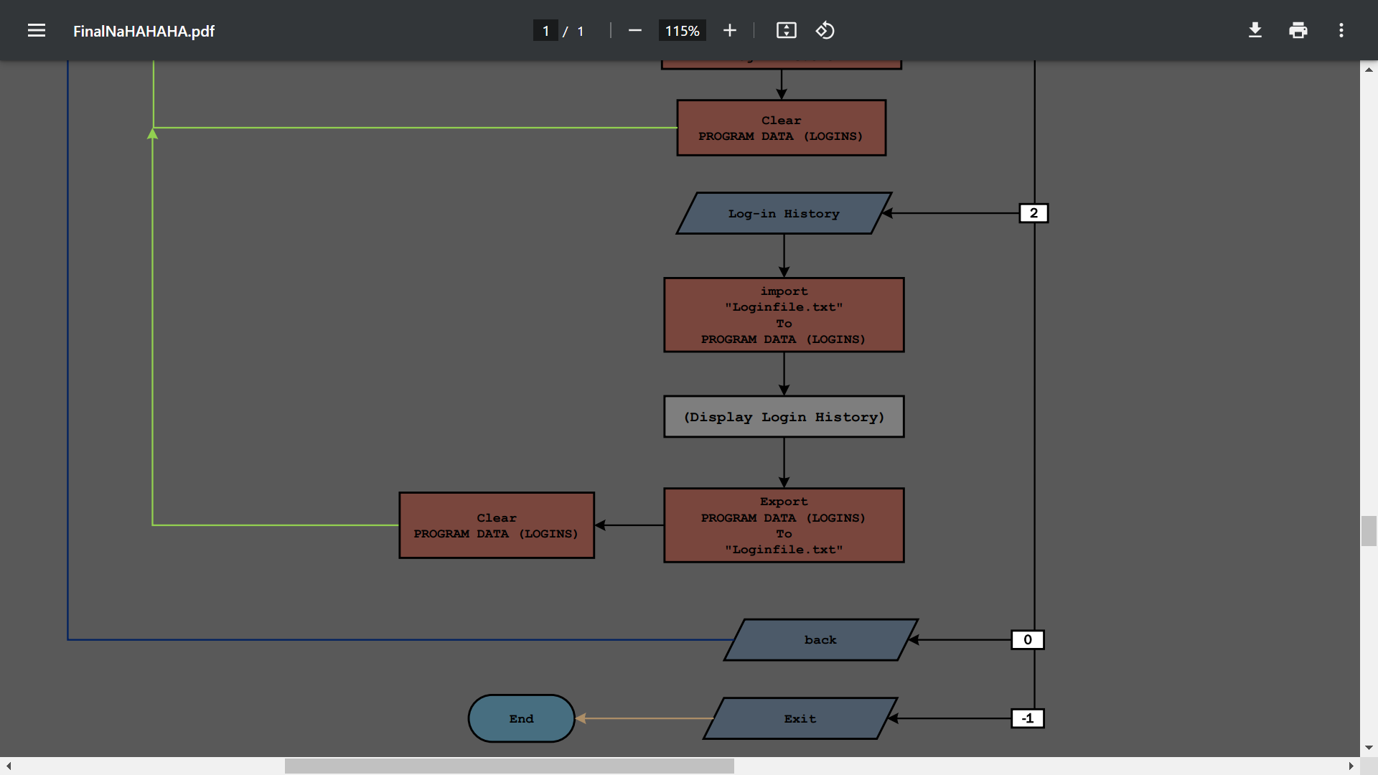
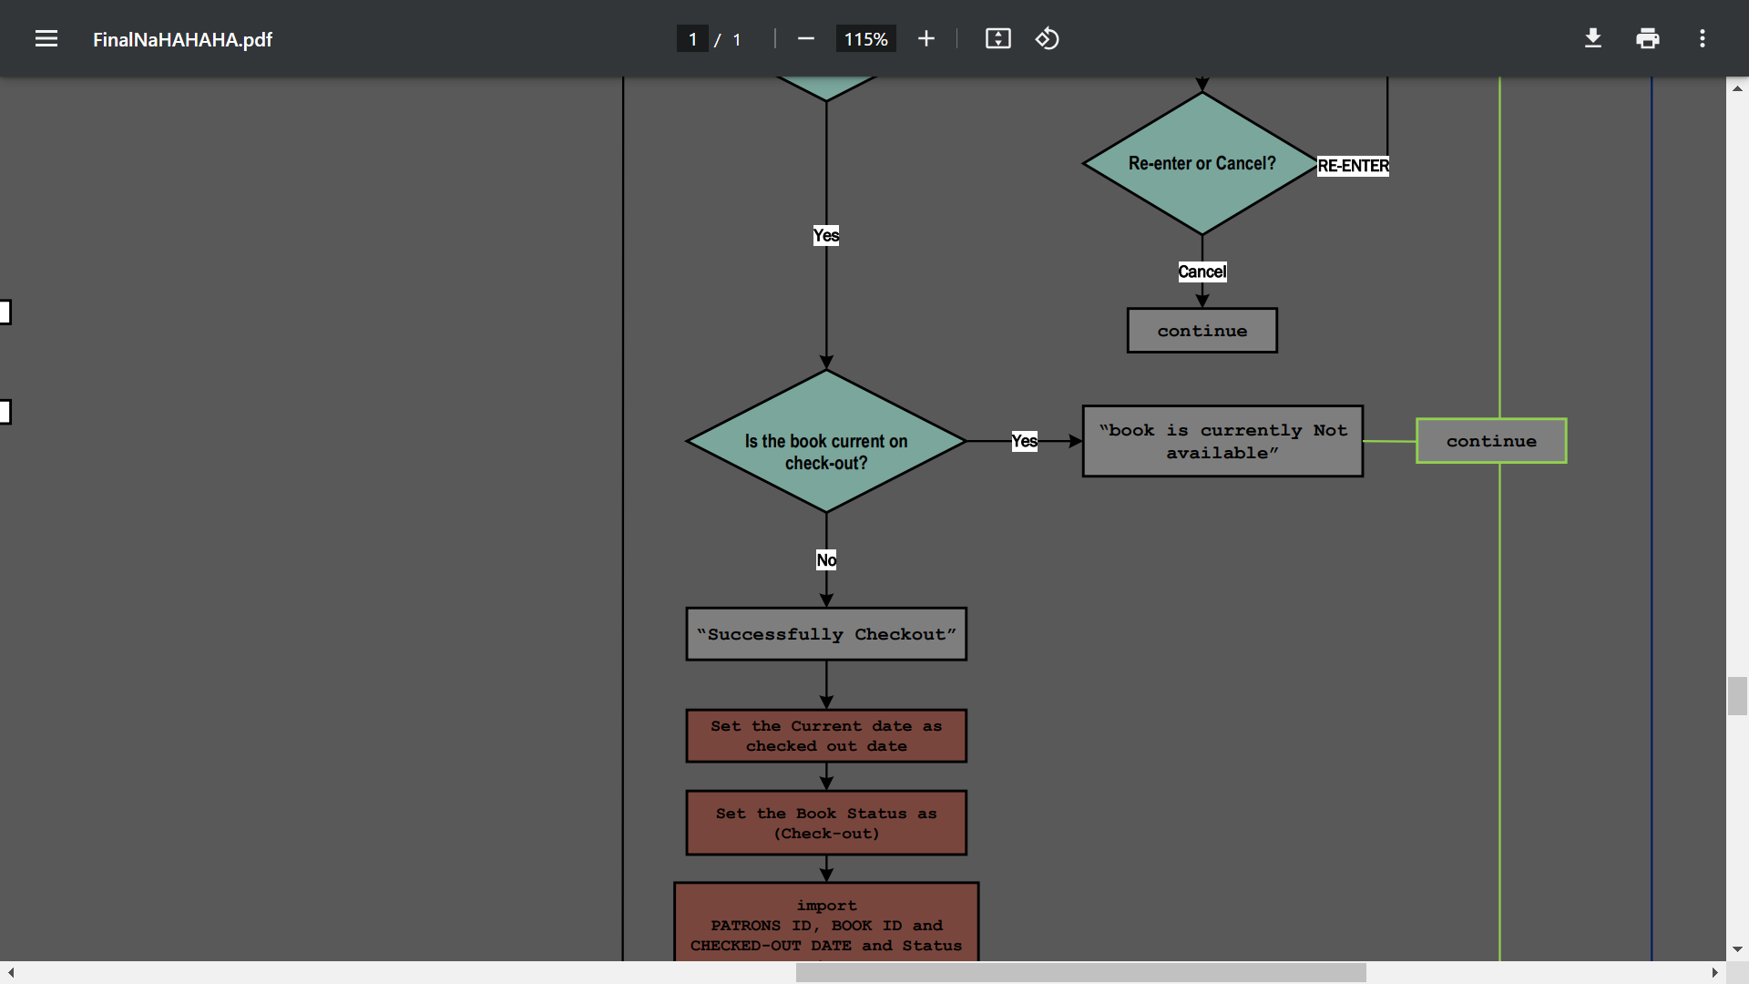
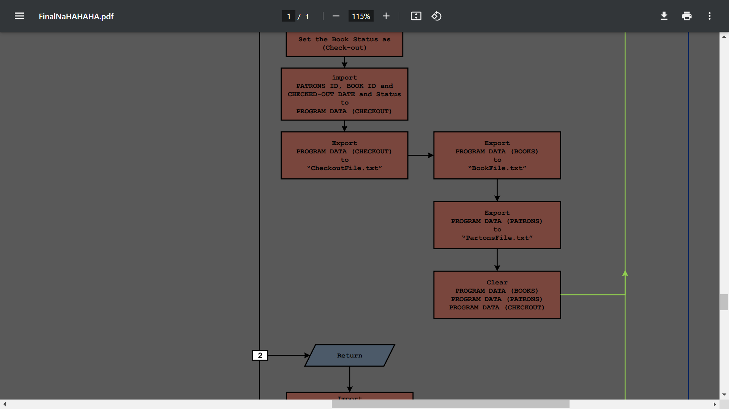
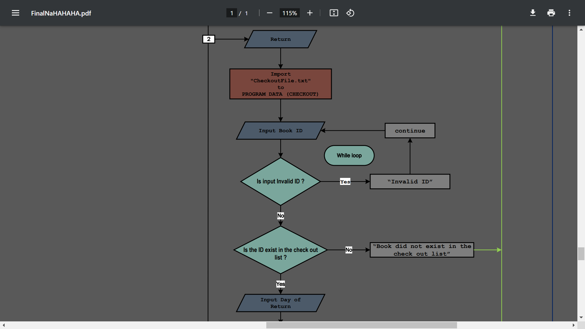
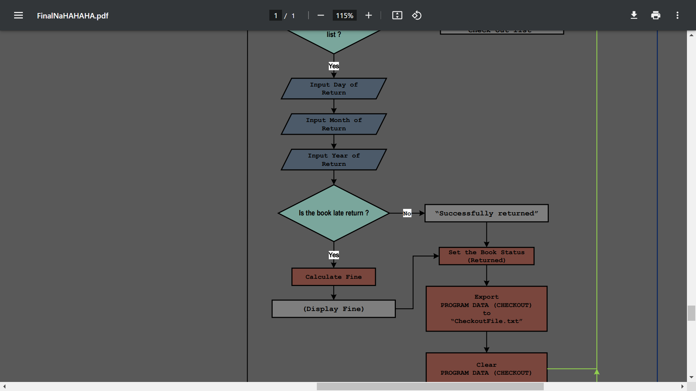
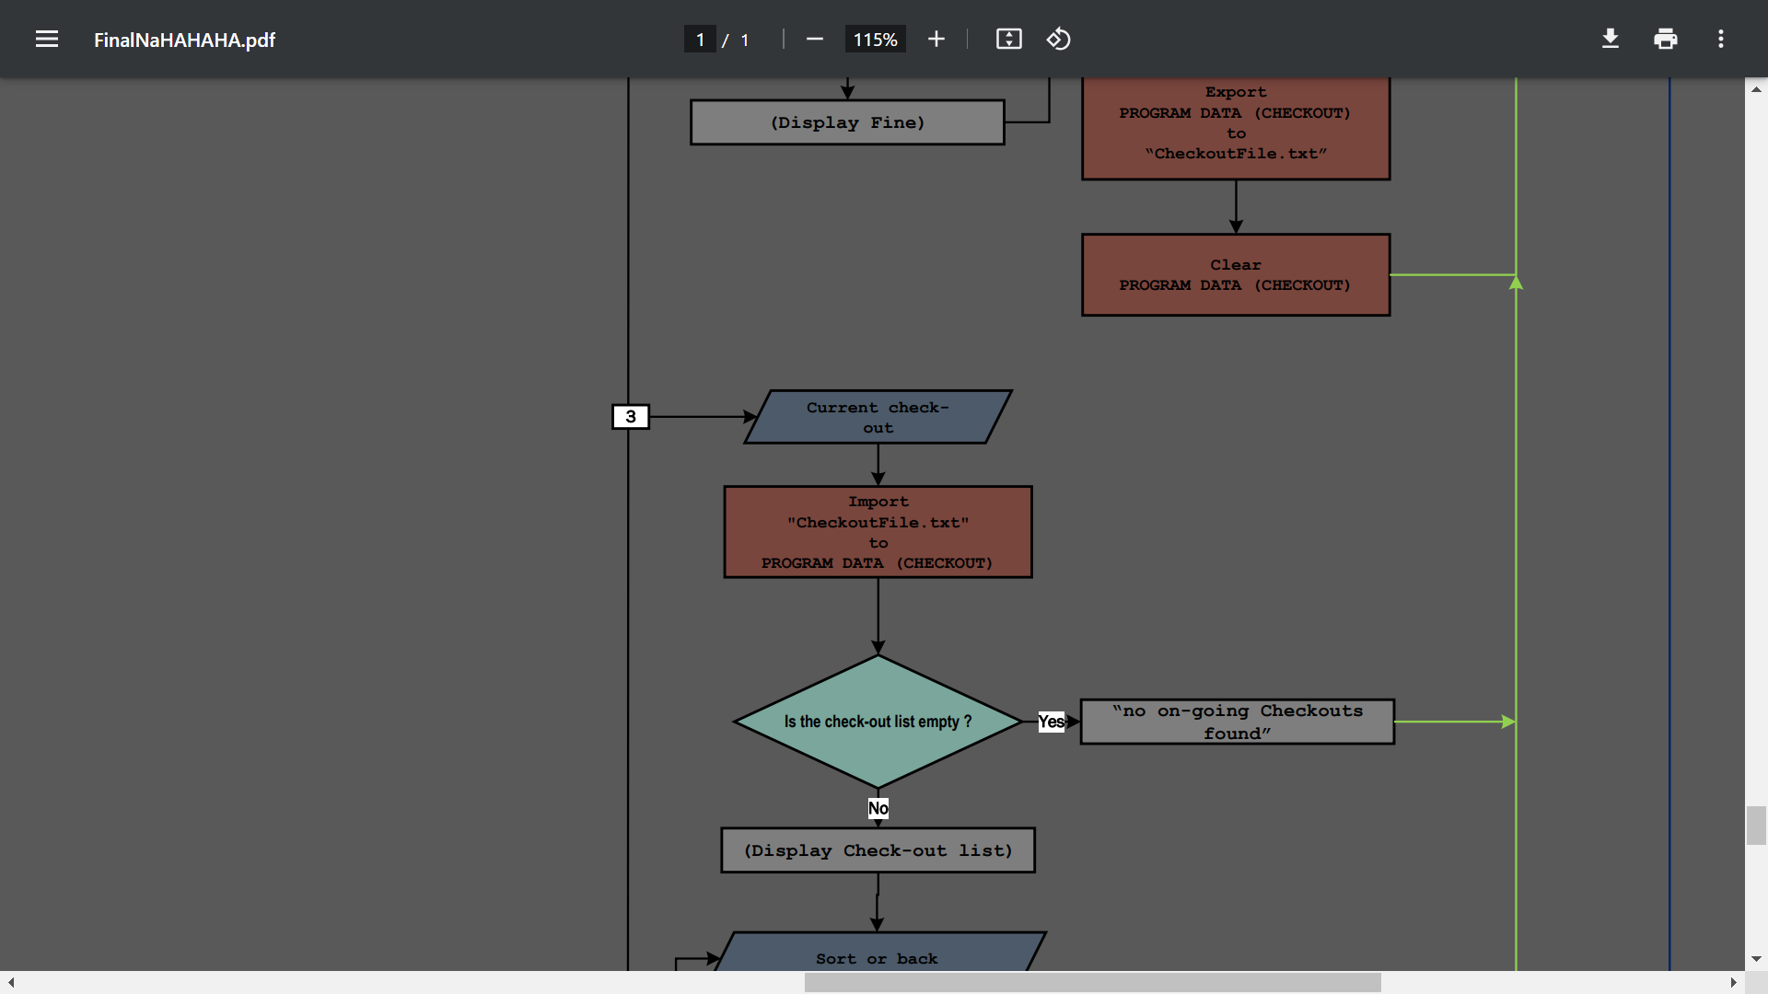
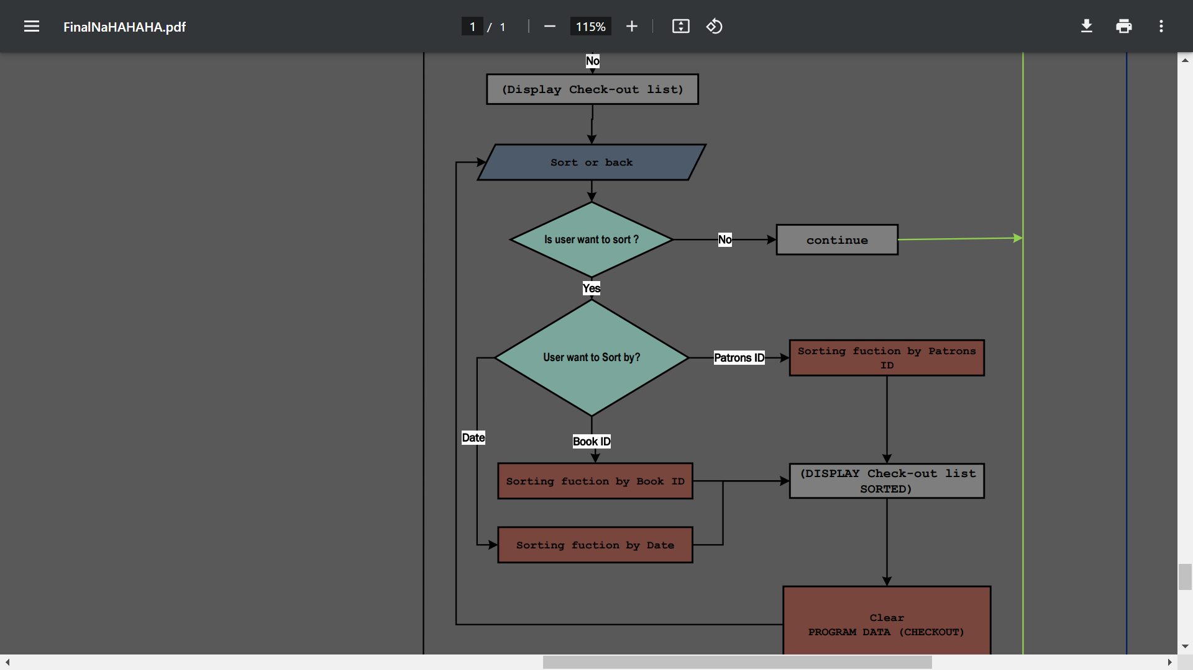
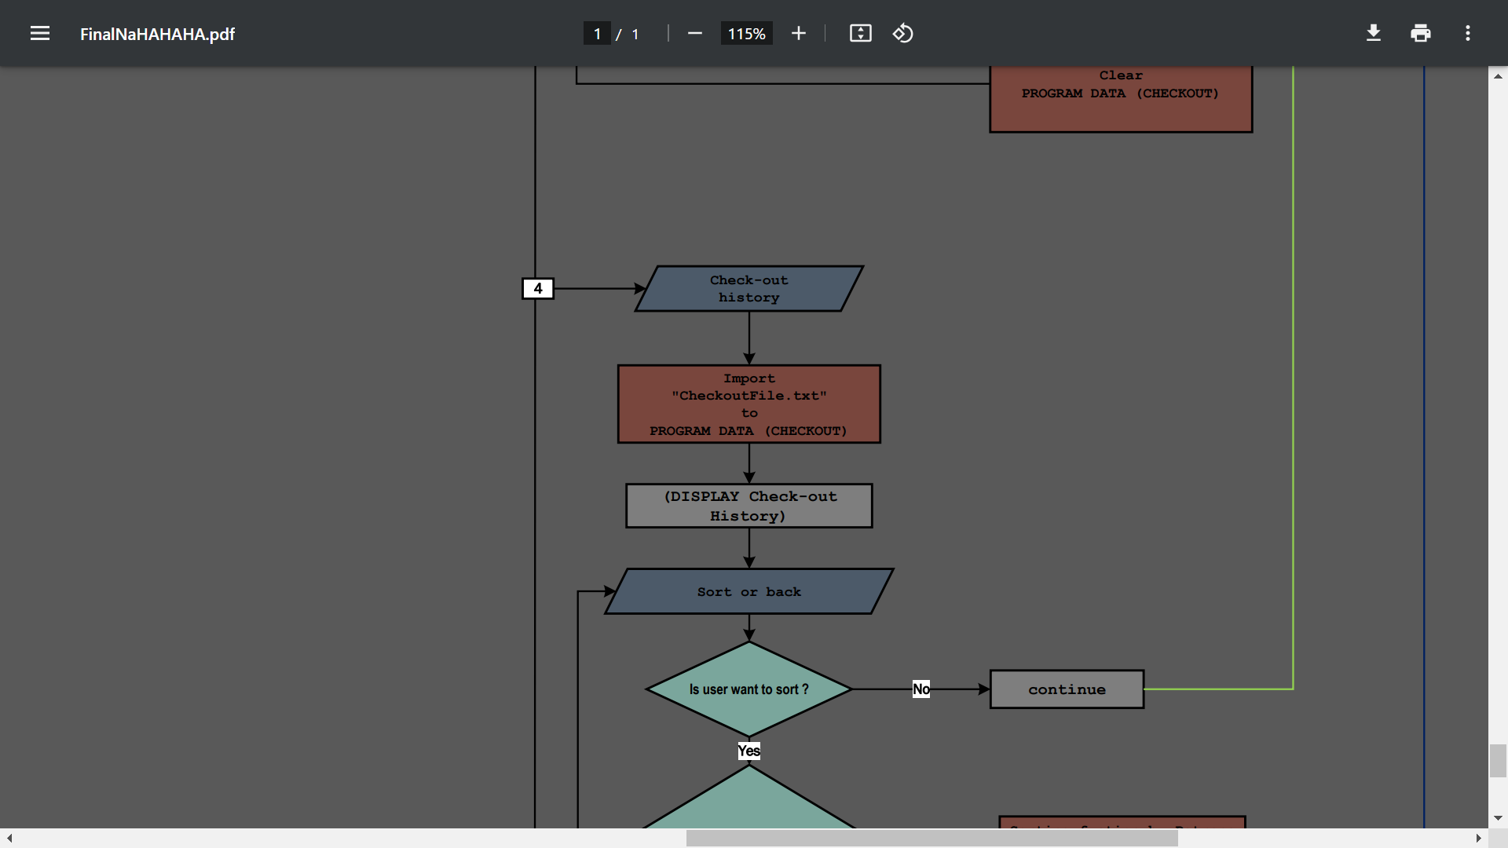



Slide 72

How the fstream function save a Program DATA to a TEXT FILE

Slide 73
#include<iostream>
#include<string.h>
#include<fstream>
using namespace std;
vector <string> programData {"String One","String Two","String Three"};
Void Exporting_programData{
fstream DataBase;
DataBase.open("TextFile.txt",ios::out);
if(DataBase.is_open()){
for(int i = 0; i < (int)(programData.size()) ++i){
DataBase<<programData[i];
}
DataBase.close();
}
else{
cout<<"Can't open the TextFile"<<endl;
}
}

Slide 74

How the fstream function import the TEXT FILE to Program DATA

Slide 75
#include<iostream>
#include<string.h>
#include<fstream>
using namespace std;
vector <string> programData;
Void Importing_programData{
fstream DataBase;
string input;
DataBase.open("TextFile.txt",ios::in);
if(DataBase.is_open()){
while(getline(DataBase,input)){
programData.push_back(input)
};
DataBase.close();
}
else{
cout<<"Can't open the TextFile"<<endl;
}
}

Slide 76

How we Manipulate the Data Base / Text File to the program

Slide 77
THANK YOU!
BY:
JONAS OLOROSO
&
JOHN CARLO BRIONES

Slide 78


Login

Slide 79

HOME

Slide 80

MANAGE BOOKS

Slide 81


ADD BOOK

Slide 82


SEARCH BOOK

Slide 83


UPDATE BOOK

Slide 84



Slide 85



DELETE BOOK

Slide 86


DISPLAY BOOKS

Slide 87
MANAGE PATRONS

Slide 88
ADD PATRONS

Slide 89
SEARCH PATRONS

Slide 90
UPDATE PATRONS

Slide 92
DELETE PATRONS

Slide 93
DISPLAY PATRONS

Slide 94

MANAGE CHECK-OUTS & RETURNS

Slide 95




CHECK-OUT BOOK

Slide 96


RETURN BOOK

Slide 97

DISPLAY CURRENT CHECK-OUTS

Slide 98



Slide 99
DISPLAY CHECK-OUT HISTORY

Slide 101


LOGIN SETTINGS

Slide 102

CHANGE PASSWORD

Slide 103

LOGIN HISTORY

